Slide 1
Financial Overview of Fermilab
Cindy Conger, Chief Financial Officer
Community Advisory Board
3 December 2015

Slide 2
Fermilab Business information
Fermi Research Alliance LLC holds the contract with DOE to run Fermilab
  Fermilab is a place, not a legal entity. FRA does business as “Fermilab.”
  The US government (DOE) owns the facility and is represented by the Fermi Site Office headed by Mike Weis.
FRA is known as a “Management & Operating (M&O) Contractor”
Employees work for FRA, not the federal government.
FRA is a 501(c)(3) non-profit organization.
Fermilab’s fiscal year is the same as the federal government’s – October 1st to September 30th.

Slide 3
DOE Contract DE-AC02-07CH11359
Between Fermi Research Alliance LLC and DOE
Effective January 1, 2007
Modified 168 times since then
540 pages long

Slide 4
Fermilab Funding > 99% from Federal Government
Nearly 95% from the Office of High Energy Physics (OHEP) within the DOE’s Office of Science.
  Remaining funding comes from other DOE programs, other labs, and external customers
FY2016 President’s Budget Request:
  DOE $29.9B
    Office of Science $5.3B
      Office of High Energy Physics $788M
        Fermilab $374M
Fermilab funding comes in ~60 different buckets representing particular mission-related programs (e.g. Facilities Operations, Cosmic Frontier Research)

Slide 5
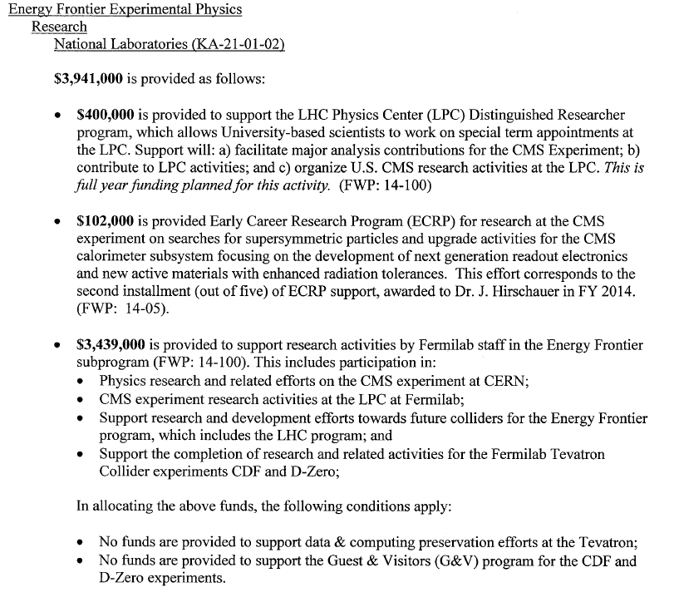
Example Work Authorization/Approved Financial Plan

Slide 6
FY2015 Financial Results – DOE Contract

Slide 7
Questions?

