Slide 2
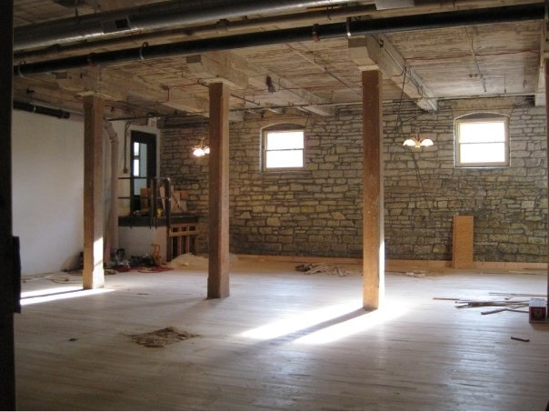
Community Art Center
501(c)3 not-for-profit organization
Founded in 2009 by a group of artists, the property owner, the City of Batavia, and the community at large.

Slide 3
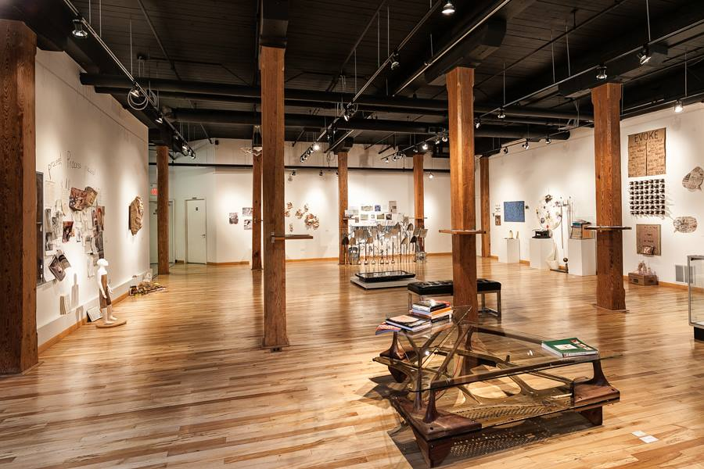
Gallery
Mission: Batavia Artists Association at Water Street Studios was founded to advance art education and appreciation by developing the promotion of fine arts in Batavia and neighboring communities. As an integral part of our community, the Batavia Artists Association at Water Street Studios strives to create a personal and diverse venue for creativity, collaboration, expression and education.

Slide 4
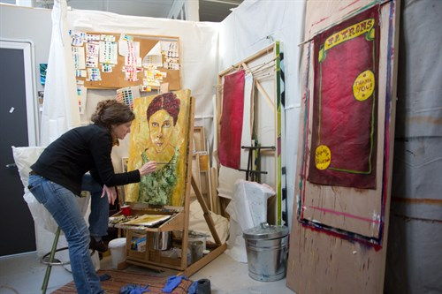
28 artist Studios

Slide 5
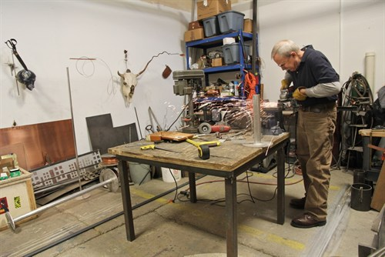
28 artist Studios

Slide 6
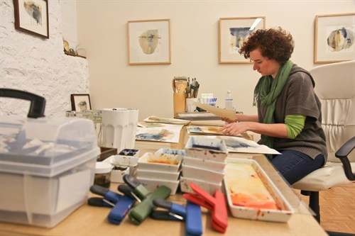
28 artist Studios

Slide 7
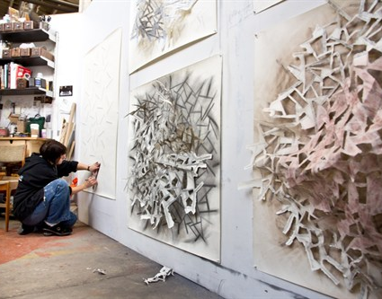
28 artist Studios

Slide 8
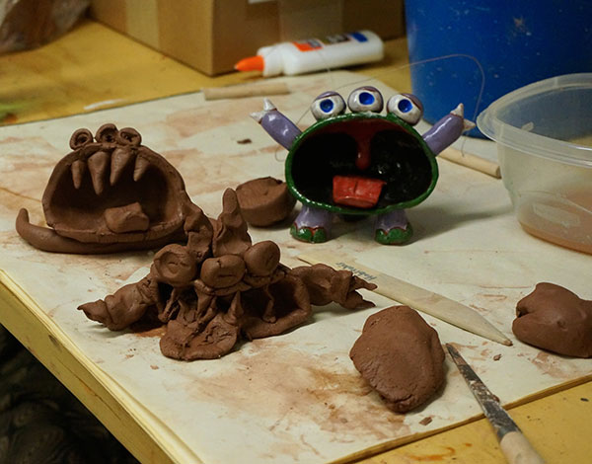
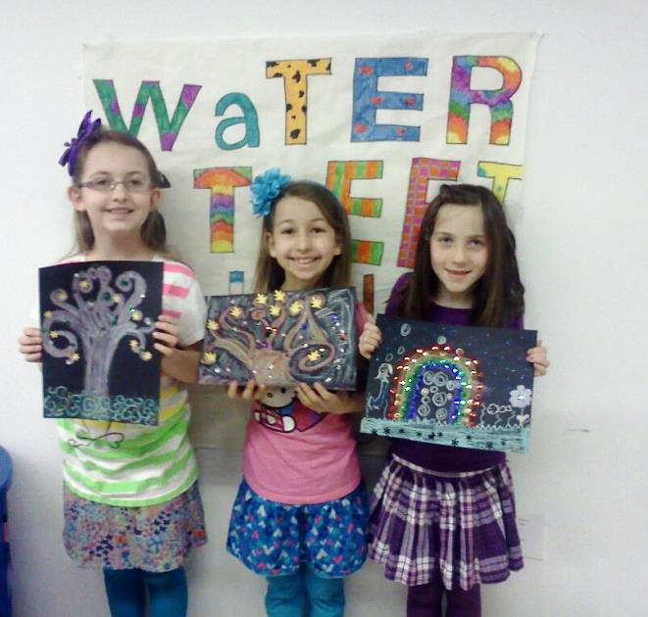
Classes
Day camps
Drop-in Sundays

Slide 9
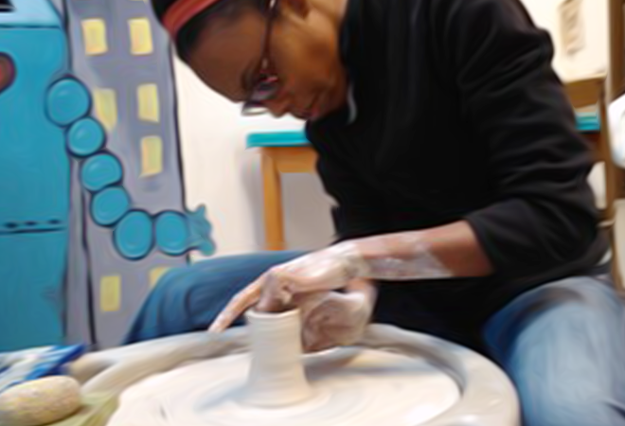
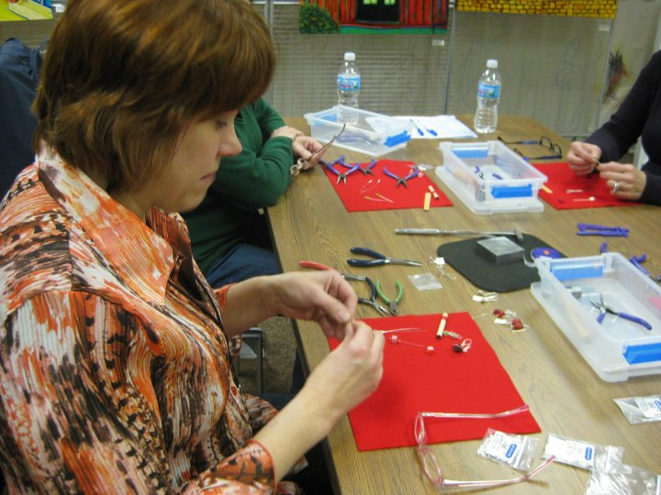
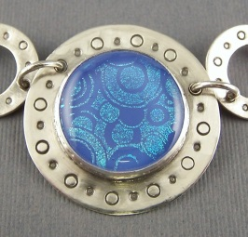
Adult Classes
Ceramics
Jewelry
Glass
Drawing
Painting

Slide 10
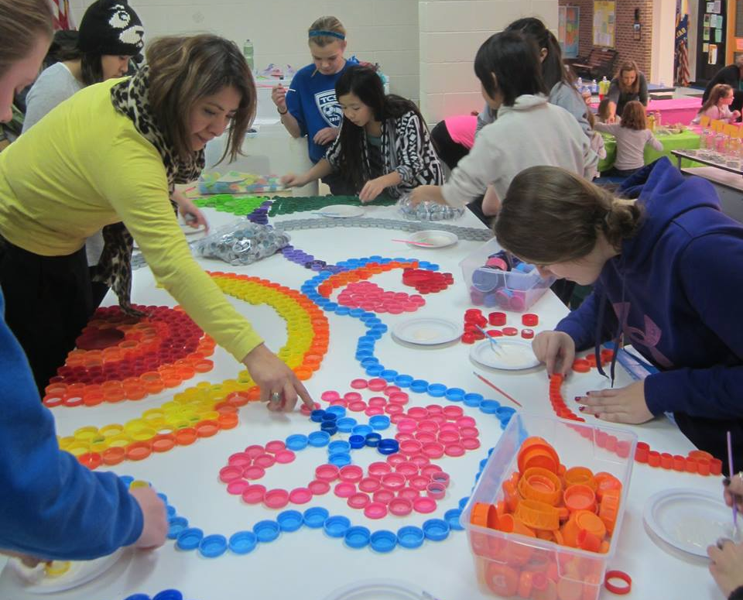
Outreach
School programs
Batavia Apts
Womens Shelter
Artflow

