Slide 1
Tritium Management Update for CAB
July 23, 2026
Chris Greer
Tritium Management Lead and Tritium Task Force Chair

Slide 3
Agenda
Today
Tritium History at Fermilab and Tritium 101
Tritium Monitoring
Tritium Management Actions
Public Communication

Slide 4
History at Fermilab and Tritium 101
01

Slide 5
Tritium and Environmental Monitoring at Fermilab
Fermilab has had an environmental monitoring program for about 50 years.
In 2005, the program detected, for the first time, tritium in surface water and in the sanitary sewer on the Fermilab site.
  We immediately informed the regulatory agencies, our neighbors and employees and the public.
  August 2024 article by Robert Crease: Had a leak from your science facility? Here’s how to deal with the problem – Physics World (https://physicsworld.com)
Levels were, and continue to be, well below already conservatively protective regulatory limits.
  Highest level has been <20% of limit; the rest are <1% of limits
We strive to minimize tritium discharges, keep the public informed, and seek input on our plans and goals.
We have a Tritium Task Force and Tritium Management staff that implement improvements to reduce tritium levels
  The TTF includes accelerator and engineering experts as well as Environment, Safety and Health (ESH) and DOE staff

Slide 6
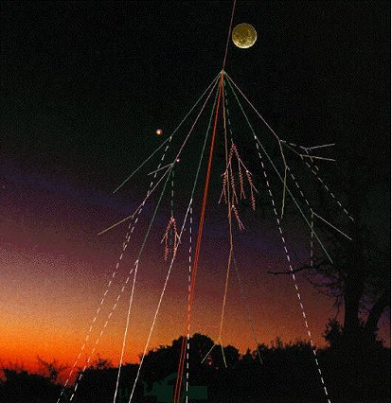
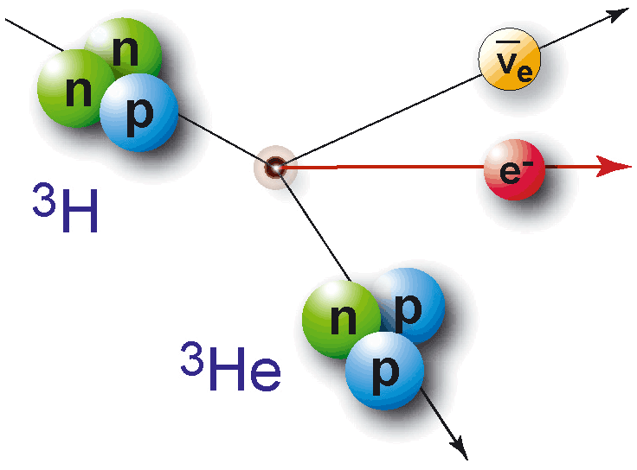
Tritium 101
Background and basics
Tritium (³H) is a weakly radioactive form of
hydrogen with a half-life of 12.3 years.
  In nature, tritium is produced when
  cosmic particles hit the atmosphere.
  Residual from nuclear tests (pre-1970s).
  At Fermilab and other particle accelerators, tritium is a byproduct of operation.
Its decay emits particles of very low energy that cannot penetrate the skin.
Tritium can only be harmful if people
drink water with high levels of tritium
over many years.
  Tritium does not build up in biological tissues; the biological half-life for tritiated water (HTO) is about 12 days.

Slide 7
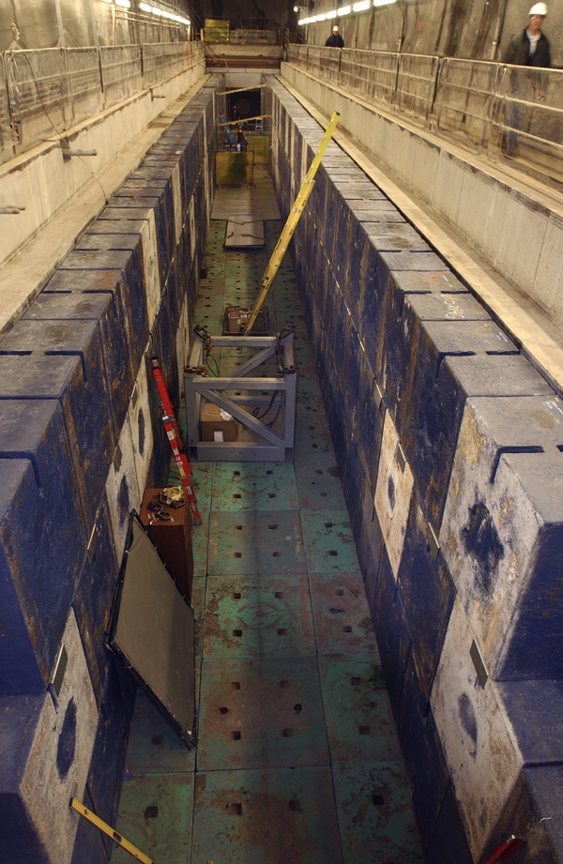
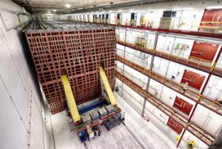
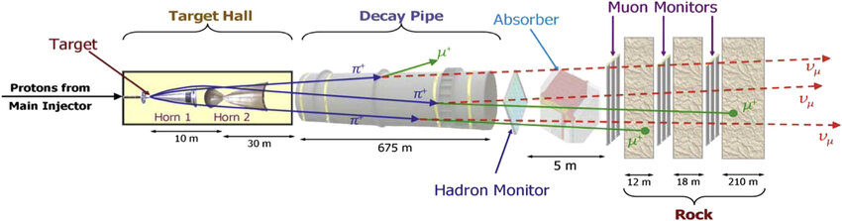
Tritium: A Byproduct of Accelerators
High-energy protons hitting or traveling through materials produce tritium (³H).
  Typical materials used in experiments at Fermilab: iron, concrete, carbon, air, water, etc.
When protons or other particles hit nuclei in the atoms in materials, they “shatter” these nuclei into pieces.
  Some are stable, others are radionuclides like ³H.
Upon exposure to air, the ³H atoms combine with oxygen to make HTO molecules (tritiated water) with the same structure as H₂O (water).
  “HTO” water moves just like regular water.
NuMI target hall shield blocks, before horn and target installation
(J. Hylen)
NuMI schematic
(Neutrinos from the Main Injector)
Far detector in MN
(no tritium production)

Slide 8
Tritium Monitoring
02

Slide 9

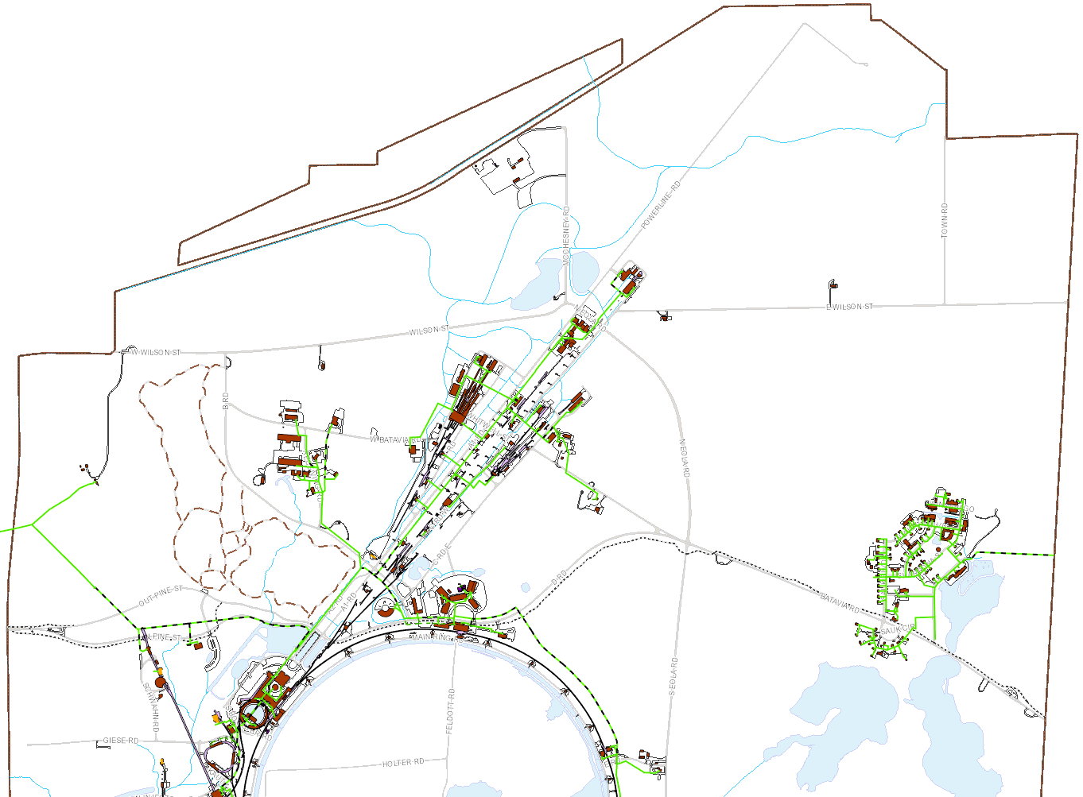
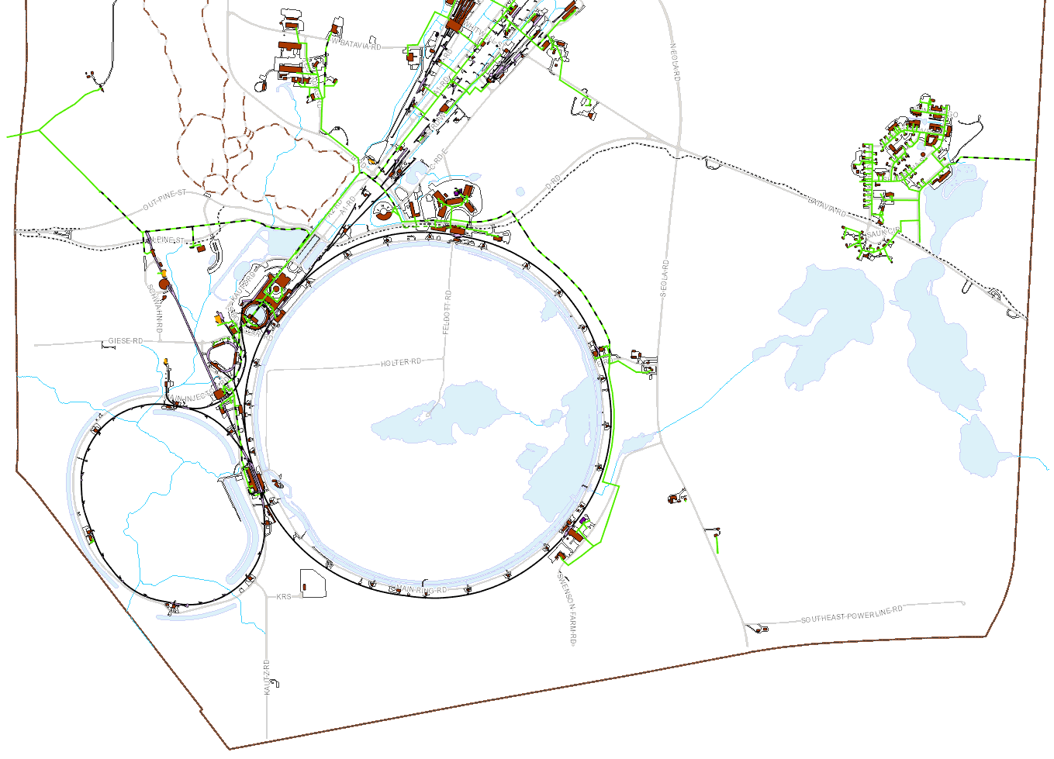
2025 results as % of Limit:
Kress Creek
(<1 pCi/ml)
Sanitary Sewer
  5 Ci in a year
Surface Water
  2,600 pCi/ml
Groundwater
  1 pCi/ml (Class 1 Resource Aquifer in bedrock)
Air (all Accelerator-Produced Isotopes, or APIs)
  10 mrem/year dose from all emissions
  0.1 mrem/year from single highest emission point (monitoring goal)
1.3%
Background (4 wells)
0.06%
Warrenville autosampler
SeaQuest
Non-detect (<1 pCi/ml)
Batavia autosampler
Site 29
Well 4
Meson/Neutrino (5 wells)
Debonding Oven
EAV2/3
CUB
Booster (4 wells)
MI-12
(3 wells)
AP-1
C-0 (1 well)
All APIs: 0.11%
Tritium: 0.009%
MI-65 (2)
NuMI Target Hall (2 wells)
Site 56
Ferry Creek
(<1 pCi/ml)
All APIs: 11.5%
Tritium: 0.92%
Site 58
Indian Creek
(1.6 pCi/ml)
MI-40 (1 well)
Tritium Discharges at Boundaries in 2025 Relative to Regulatory Limits
Aligned with DOE Orders and Standards, Illinois Administrative Code and NESHAPS Procedures (40 CFR Part 61 Subpart H: National Emissions Standards for Hazardous Air Pollutants from DOE Facilities)

Slide 10
Standards for Surface and Drinking Water
DOE Surface water limit for offsite discharge: 2,600 pCi/ml (picocuries per milliliter).
Federal limit for drinking water systems: 20 pCi/ml. Fermilab surface water is NOT drinking water.
What do these standards mean?
1 picocurie (pCi) = 0.037 atoms decaying each second.
Threshold for measurement is usually taken to be 1 pCi/ml.
  A user of 2,600 pCi/ml water for their household water source full time would receive a radiation dose of 100 mrem each year. For comparison, a head CT scan creates about 200 mrem (source: Nuclear Regulatory Commission). https://www.nrc.gov/about-nrc/radiation/around-us/doses-daily-lives.html
  A user of 20 pCi/ml water for their household water source is assigned a dose of 4 mrem each year by U.S. EPA.
  Globally, rainwater is <0.5 pCi/ml due to cosmic rays and residual from nuclear weapons tests (ending in 1960s). SRNL-STI-2016-00071.pdf

Slide 11
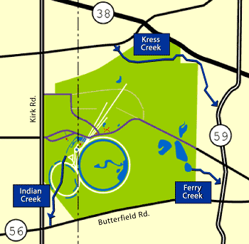
How Surface Water at Fermilab Connects to the Community
3 creeks leave Fermilab
  The Fermilab site has numerous ponds and is the origin of Indian Creek and Ferry Creek
  Kress Creek originates offsite then flows onsite then offsite again
Fermilab uses water to cool accelerators and other equipment
  Our pond system is part of an “industrial cooling water system” (ICW)
  A total of ~250,000,000 gallons, replenished primarily by precipitation

Slide 12
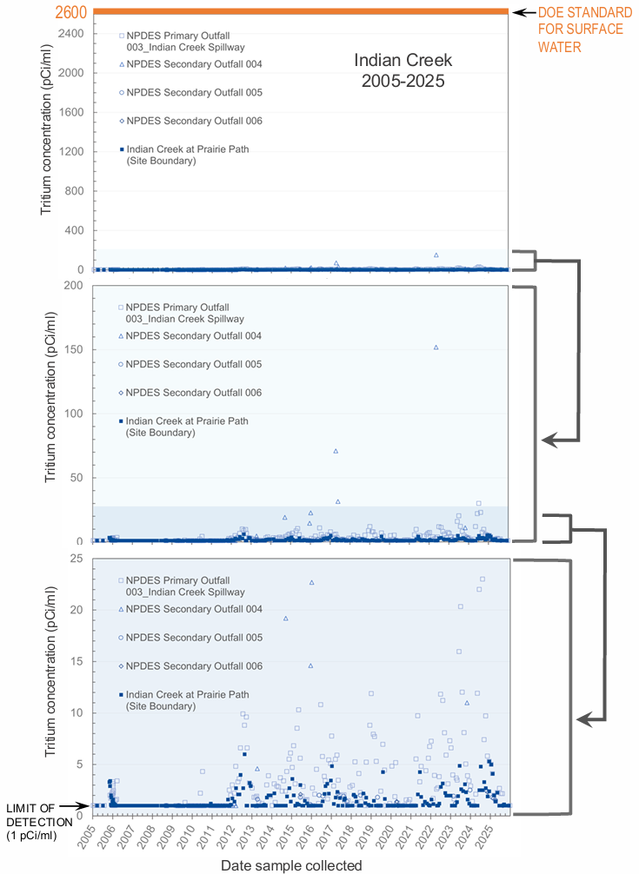
Surface Water Boundary Results: Indian Creek
Historically: 6 pCi/ml or lower
Regulatory limit: 2,600 pCi/ml
Inputs: 1 primary and 3 secondary NPDES outfalls (National Pollutant Discharge Elimination System)
Non-detect (<1 pCi/ml)
USEPA Standard for Drinking Water
<2 pCi/ml (usually <1)
Data plots and maps for all three creeks online at: https://www.fnal.gov/pub/tritium

Slide 13
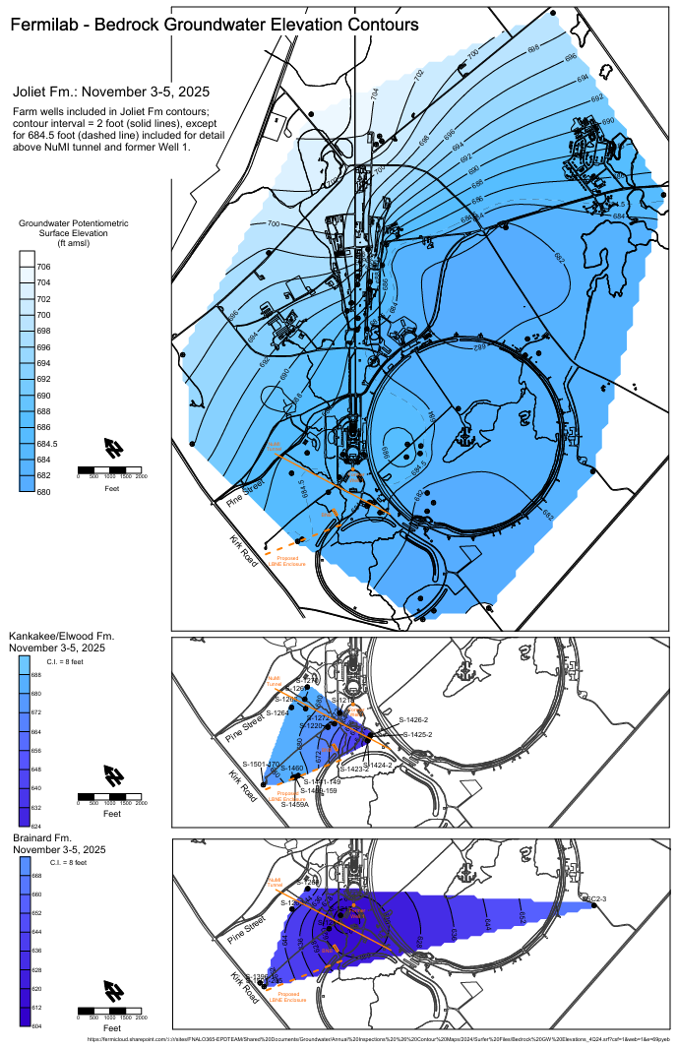
Groundwater
We must protect Illinois Class I “Resource” Groundwater.
  Found in bedrock beneath Fermilab (60-90 feet deep).
  Must stay below 1 pCi/ml in Class I aquifers (i.e, those considered by Illinois to be “useful” for drinking water).
We design and operate our experiments so that any tritium produced is below detection levels.
  Fermilab employs a hydrogeologist on its staff as an advisor.
We have never detected tritium in Class I groundwater.
  Eleven bedrock wells are sampled annually.
  More than 100 wells are measured annually to determine flow directions.

Slide 14
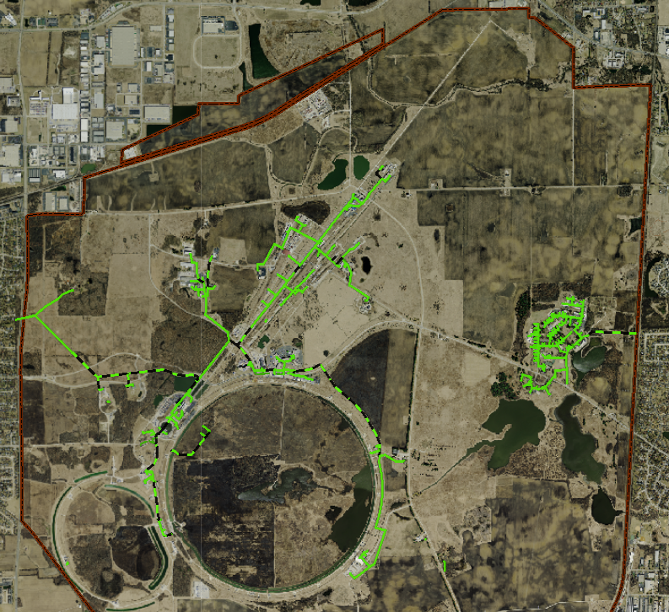
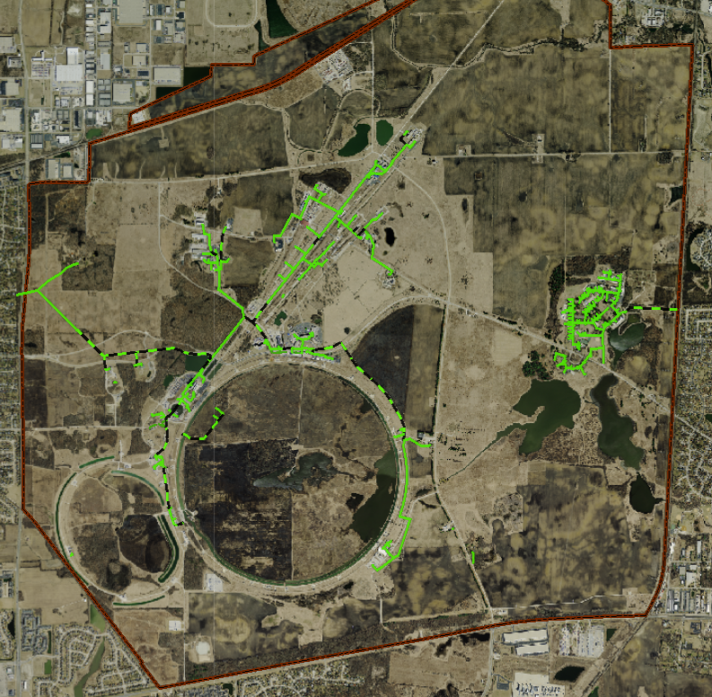
Sanitary Sewer
Routine Autosampler Locations (additional ad hoc sampled manhole vaults not shown)
Composite Sampler
(to Batavia system,
NPDES Permit)
Composite Sampler
(to Warrenville system,
NPDES Permit)
Non-detect (<1 pCi/ml)
Composite Sampler
(onsite monitoring at MC-1)

Slide 15
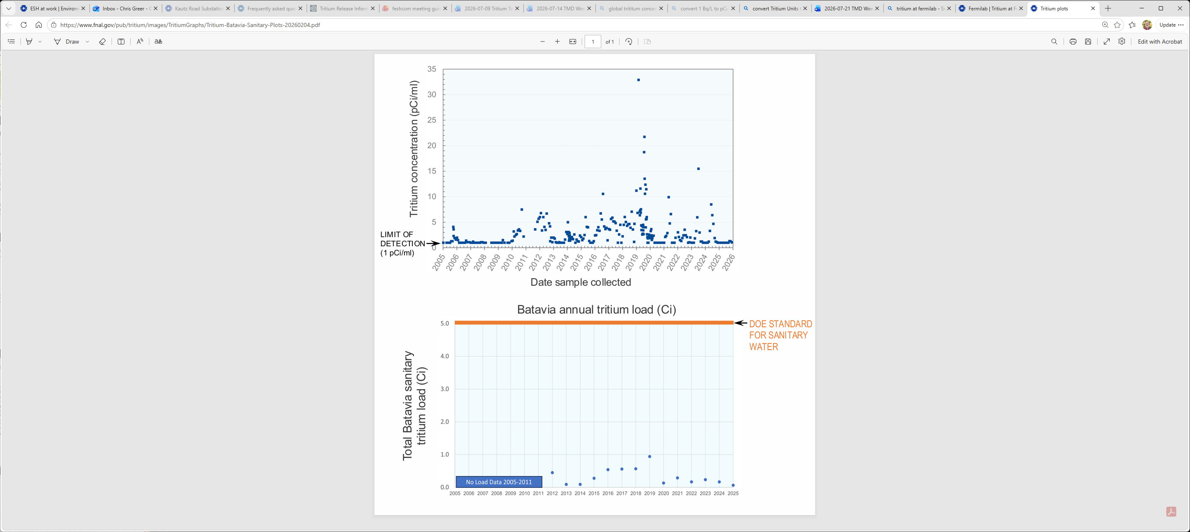
Sanitary Sewer Boundary Results: Batavia
Annual Discharge Limit to Batavia
2012-2025
The 2025 annual total tritium activity load was 1.3% of the 5 Curie annual limit. This low level is due, in part, to multiple condensate management approaches:
  Air handler unit condensate is routed away from the sanitary sewer system during operational periods producing higher concentrations.
  NuMI condensate, along with some AHU condensate, is currently shipped offsite for disposal. The lab is continuously evaluating the safest and most effective method for disposal.
Historical maximum of <35 pCi/ml (usually <20 pCi/ml)
2005-2025
Data plots online at: https://www.fnal.gov/pub/tritium

Slide 16
Tritium Management Actions
03

Slide 17
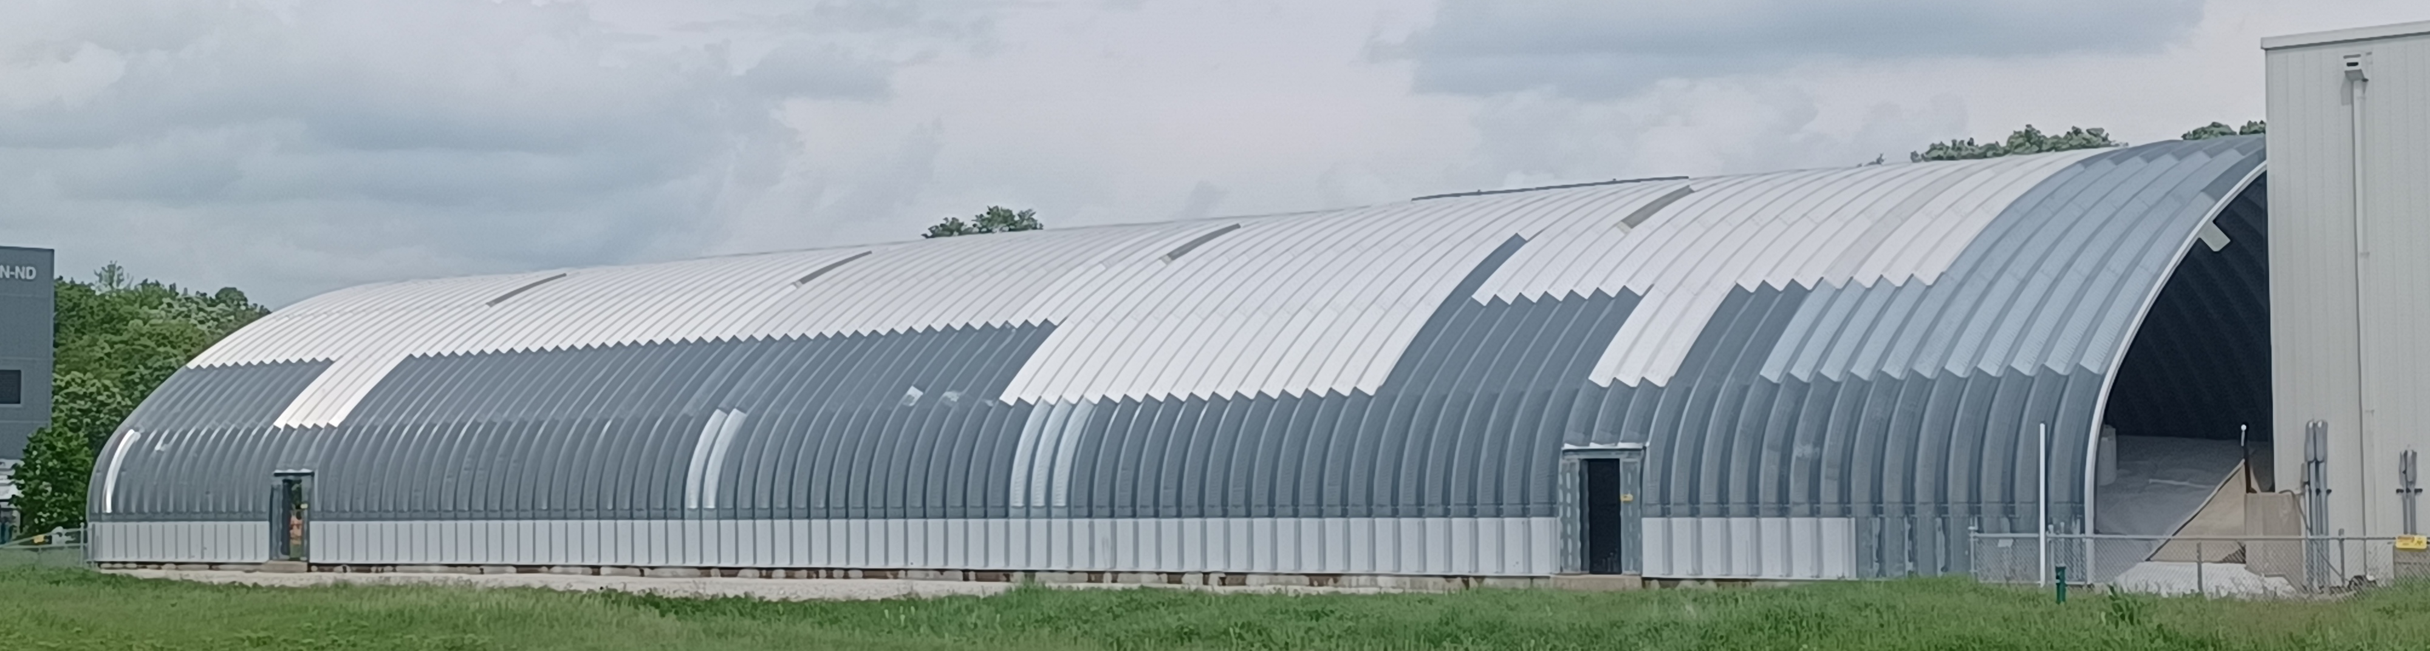
Tritium Management Actions
Booster Neutrino Beam (BNB)
In 2019 we completed installation of a canopy and liner over the BNB berm, under which we produce neutrinos for Short Baseline Neutrino (SBN) experiments
  Infiltration reduced by >90%, which means less HTO is produced
  First phase shallow groundwater monitoring wells: all <1 pCi/ml since 2021
    Bedrock wells (installed 2025): all <1 pCi/ml
BNB Canopy:
Highly-customized “farm shed” including skylight panels, egress doors and a removable section for absorber access

Slide 18
Tritium Management Actions
Recommendations from Latest External Review and DOE Assessment
2022 external review of Fermilab tritium management
Commendations included: BNB canopy, applying lessons learned to LBNF design, public communication
Recommendations included: expand automated and groundwater monitoring, elevate and expand tritium management and funding, Industrial Cooling Water management
2024 DOE Assessment of multiple programs, focusing on tritium
Five commendations, including changes to Rad Worker training and Radionuclide Analysis Facility (RAF) data management and Quality Assurance/Quality Control
Findings included 11 recommendations, including: performing a self-assessment for new TM Dept., improve procedure formats, completing release and clearance programs, RAF incorporation of MARLAP testing, etc. One sampling methodology non-conformance for passive diffuser vials (corrected in 2024, replacements in progress).
2026 external review of Fermilab tritium management planned for October

Slide 19
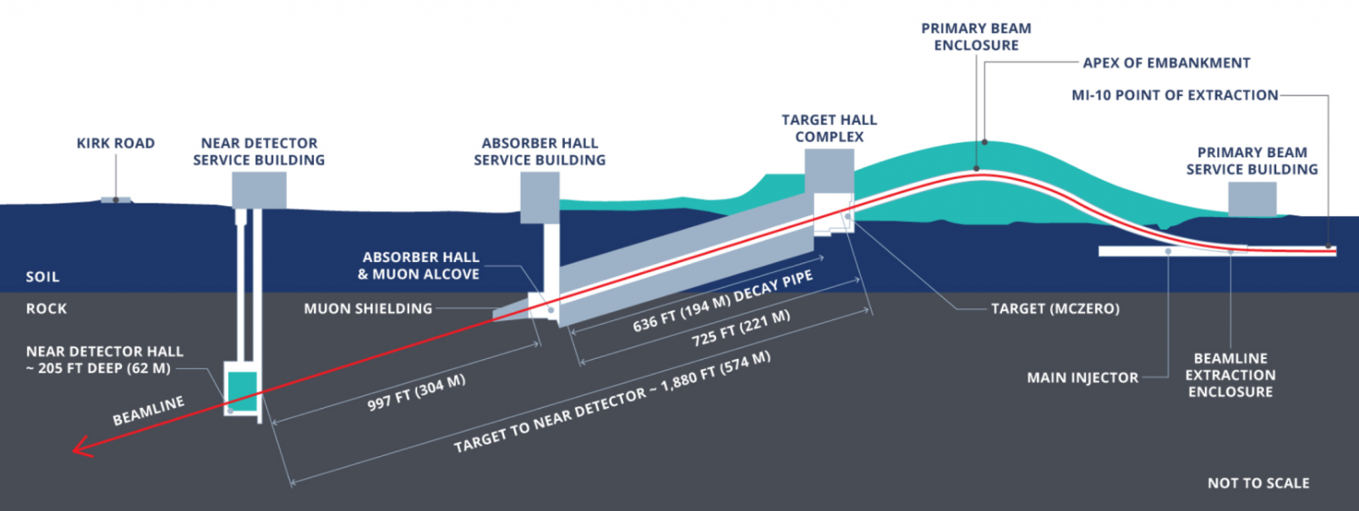
Tritium Management Actions
Long Baseline Neutrino Facility (LBNF) Near Site Design
Similar concept to NuMI, but keeping the production of tritium well below regulatory limits is a major focus on the design of this new, higher beam power facility via:
Excluding, rather than capturing, groundwater along the active Near Site beamline at Fermilab
Reducing the total depth of Near Site construction into bedrock, especially the active beamline portion
Active beamline portion is separate from the Near Detector
Changed the original decay pipe design to allow in-person verification and servicing of shielding to reduce tritium risks
Maintaining a nitrogen atmosphere rather than ambient air atmosphere in the target chase during beam operation
Goal: Deliver beam by 2031

Slide 20
Public Communication
04

Slide 21
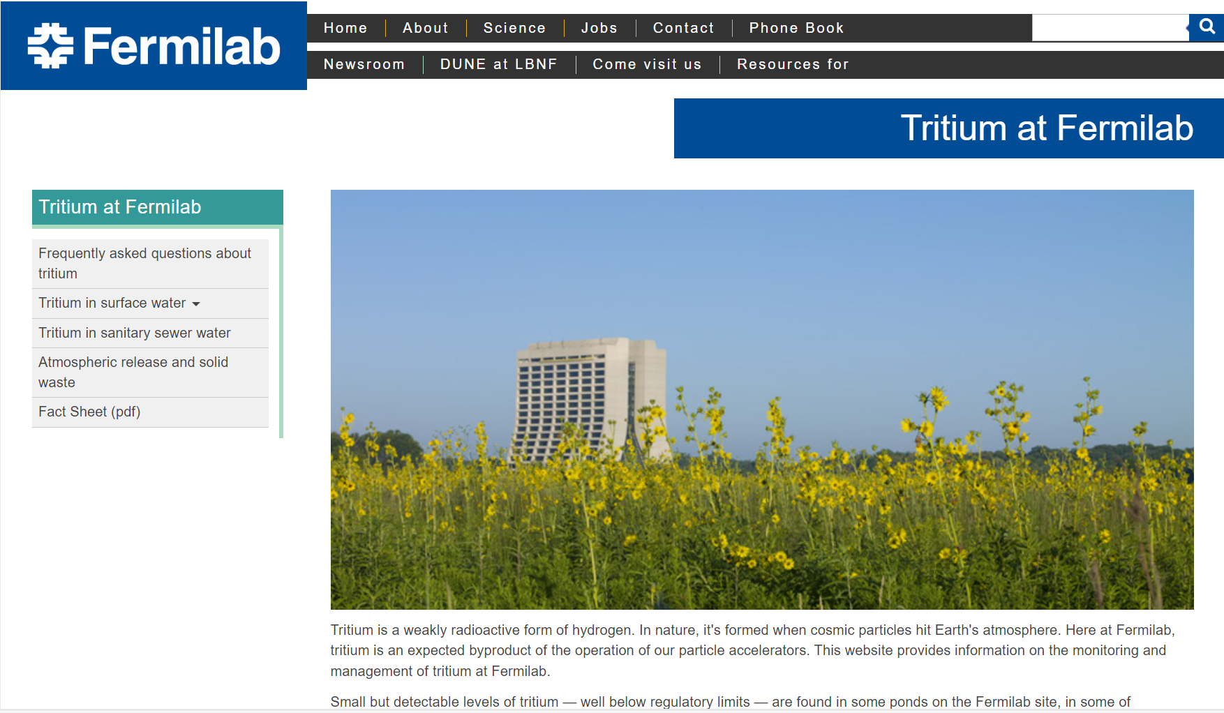
Keeping the Public Informed
We held Environmental Assessment meetings for LBNF/DUNE in 2015.
We inform the Community Advisory Board.
We update and post tritium data on our public tritium webpages.
The DOE Fermi Site Office sends a summary of tritium monitoring results at Fermilab to local officials every year.
Also publicly available:
  Annual environmental reports
  FESHM Chapters
    Fermilab ESH Manual

Slide 22
Questions for the CAB
Members of the Community Advisory Board are one of Fermilab’s connections to the community. As such, we’d like to know:
How should we keep the community informed and maintain a dialogue?
Are there specific groups or persons we should reach out to?
What questions and recommendations do you have?
We strive to be good stewards of the Fermilab site. Please let us know if you have concerns.

Slide 23
Questions from the CAB?
…?

