Slide 1
News from Fermilab
September 25, 2025
Office of Communication
Community Advisory Board

Slide 2

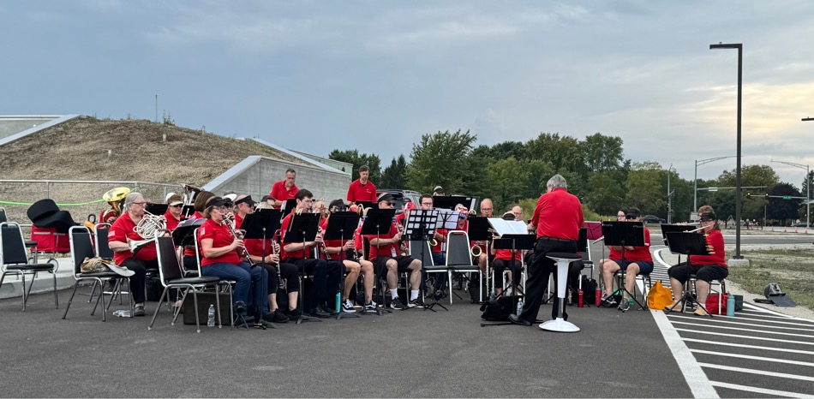
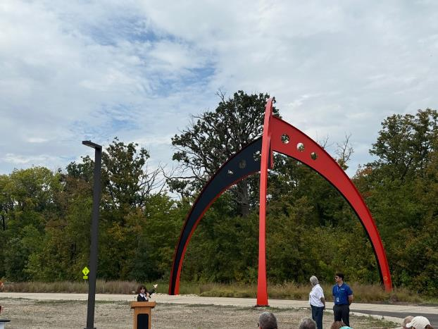
Party on Pine St. September 20, 2025

Slide 3
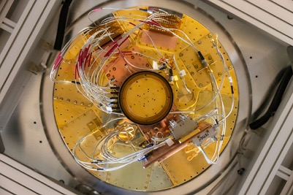
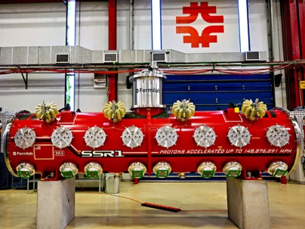
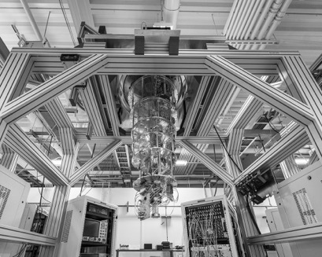
Fermilab-hosted Photowalk 2025
On July 26, two dozen photographers visited Fermilab from around the United States and Europe.
63 photos were submitted for the local competition.
Winning photos went on to the Global Physics Photowalk competition.
Social media campaign of submitted photos was viewed over 350k times.
And the winners are…
The Underside of Quantum Computing
SSR1
Quantum Computing

Slide 4
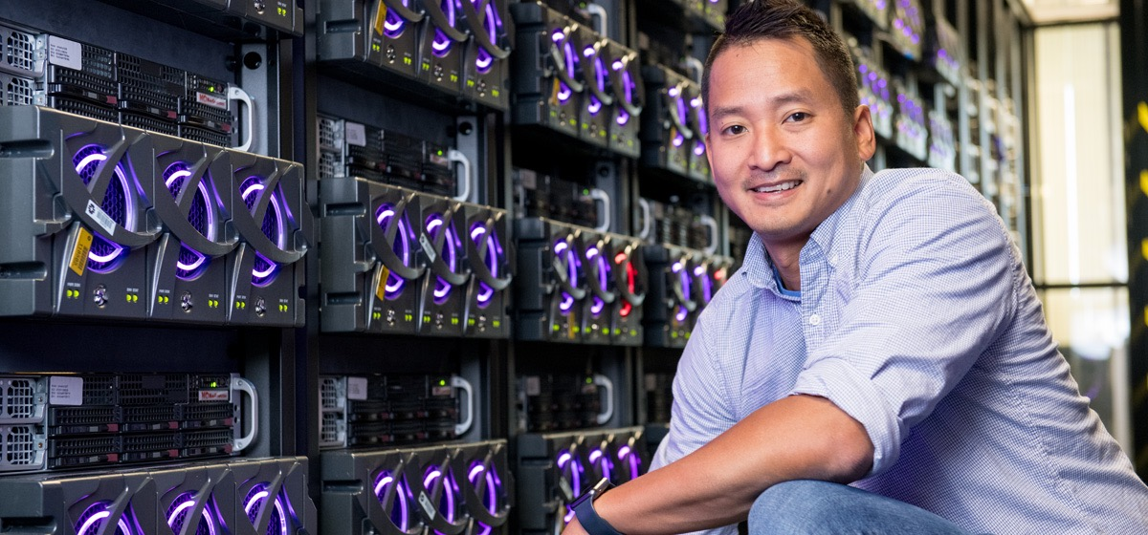
Spring at Fermilab welcomes the arrival of two baby bison
The first baby bison was born on April 21. To date there are 16 new calves.
Evening Lecture — Discovery Machines: An AI and Physics Collision Course: Thursday, Oct. 2 at 5:30 p.m. at Fermilab

Slide 5
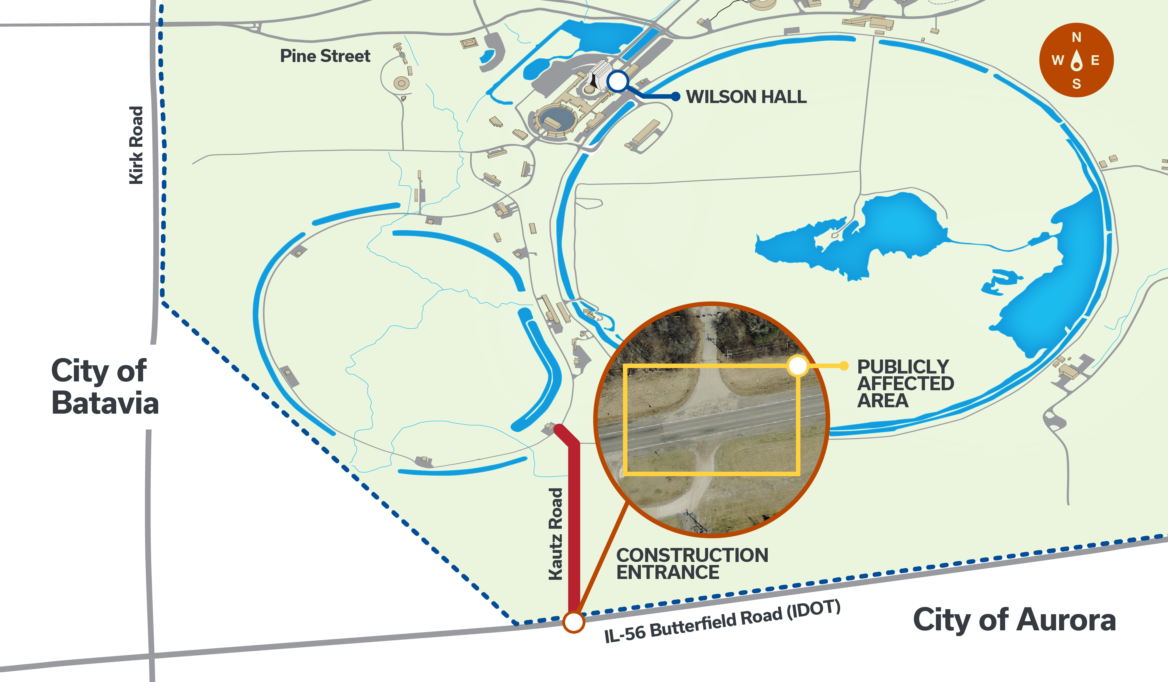
Site Updates – Kautz Rd. entrance
Three large projects – increased truck traffic for construction
Long Baseline Neutrino Facility site
Proton Improvement Plan-II accelerator upgrade
Utilities Improvement Project
Began this week (Sept 22)
Anticipated complete in Nov

Slide 6
From the Newsroom

Slide 7
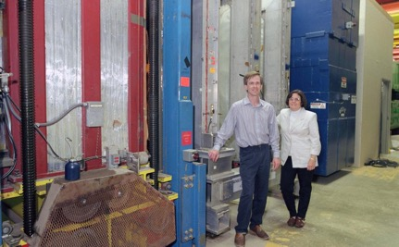
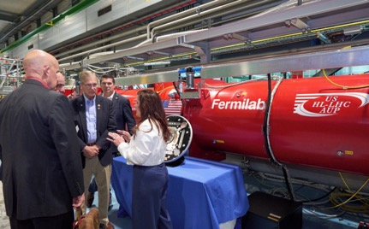
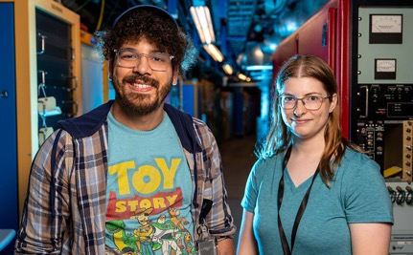
From the newsroom
July 17 – Sept. 25
How an experiment at Fermilab fixed a hole in the Standard Model - 993 views Fermilab technology debuts in supercollider dress rehearsal at CERN - 836 views Fermilab partners with community colleges to develop technical talent - 771 views A minute with Mackenzie Ring - 703 views Researchers meet at Fermilab for U.S. Higgs factory workshop - 624 views A minute with Troy England - 414 views
Most recent post on Sept. 19: Why choose liquid argon for DUNE detectors?
Fermilab scientists with the DONUT detector in 2000, the year the discovery of the tau neutrino was announced.
U.S. delegates discuss contributions to the high-luminosity upgrade of the LHC.
Internships and collaborative development provide students with real-world experiences.

Slide 8
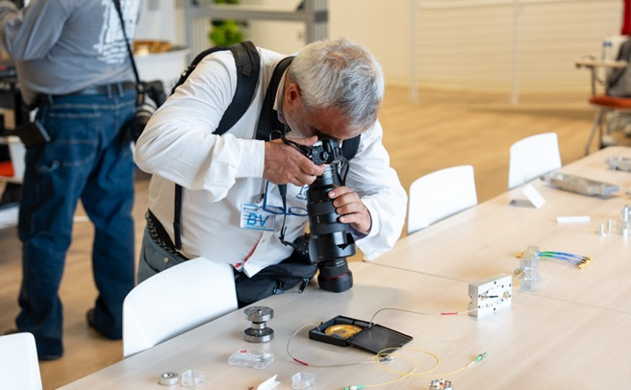
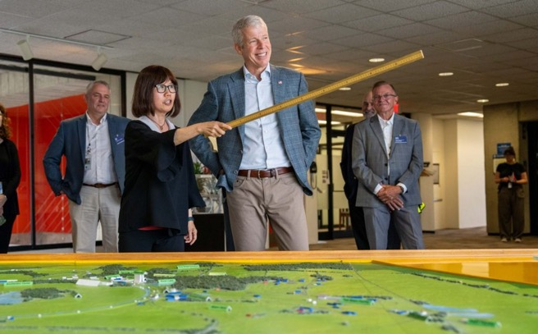
From the newsroom – press releases
Winners of the 2025 Fermilab Photowalk unveiled and submitted to global competition - 650 views
Secretary of Energy Chris Wright visits Fermilab - 909 views
In July, two dozen photographers visited Fermilab to capture behind-the-scenes areas that are typically not accessible to the public. Credit: Ryan Postel, Fermilab
.
Interim Director of Fermilab Young-Kee-Kim (center left) shows Secretary of Energy Chris Wright on July 18. Credit: Ryan Postel

Slide 9

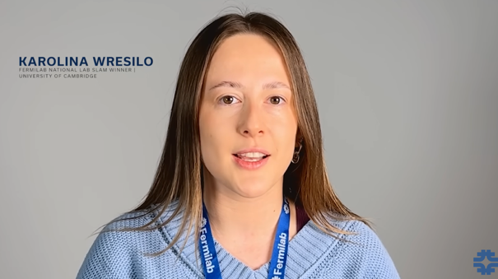
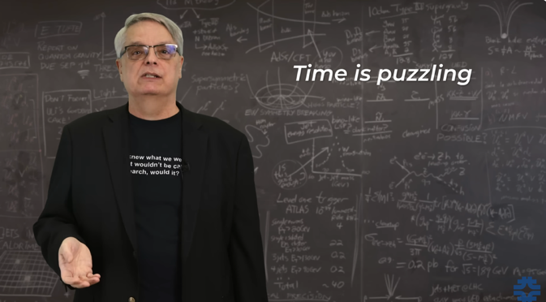
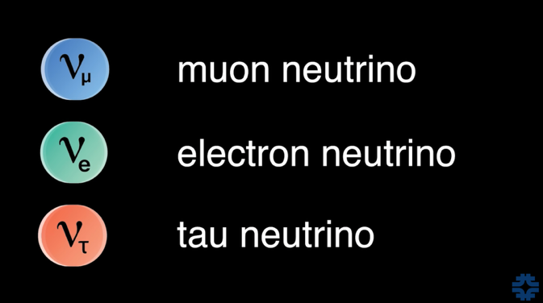
New videos
What is time? with Don Lincoln 151,640 views since June
DUNE: Seeing the invisible with Karolina Wresilo
Over 13K views since July

Slide 10
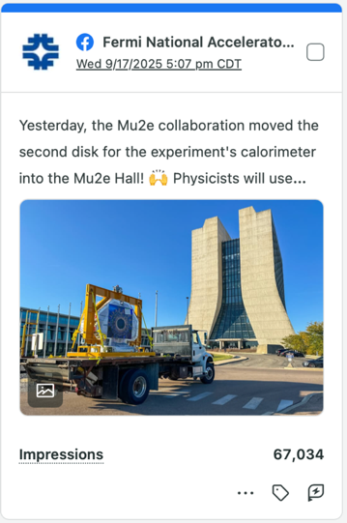
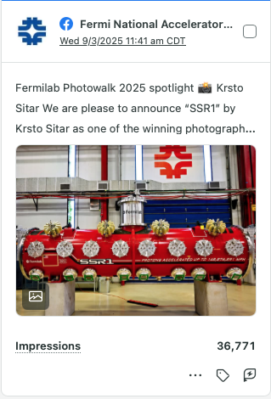
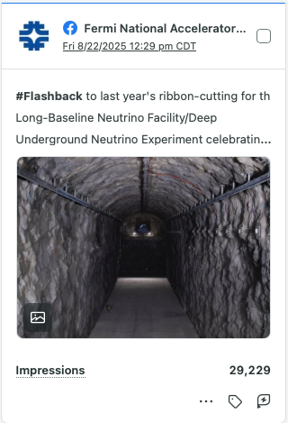
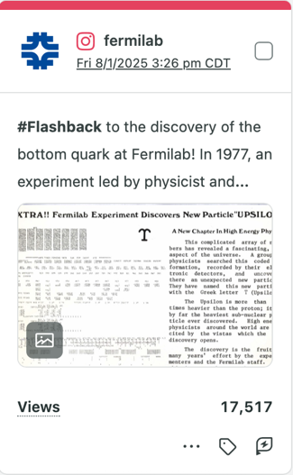
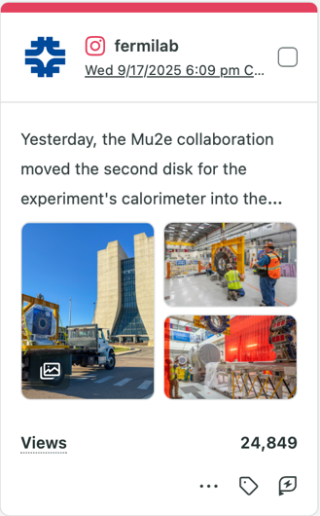
Social Media: Top posts by views

Slide 11
Fermilab In the News

Slide 12



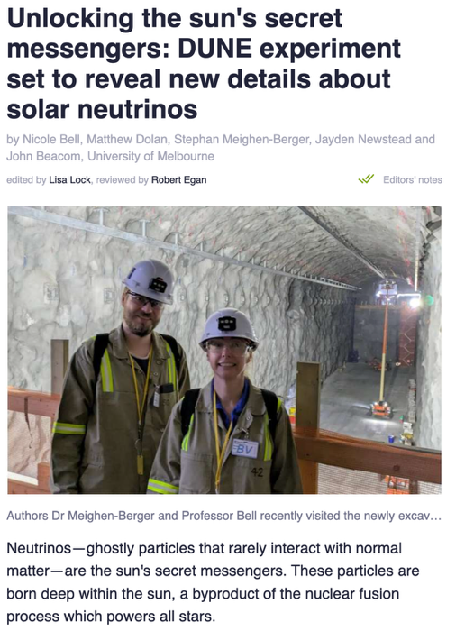
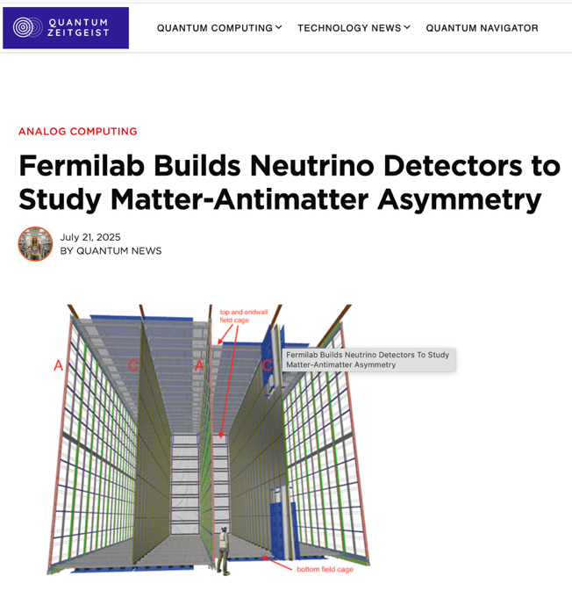
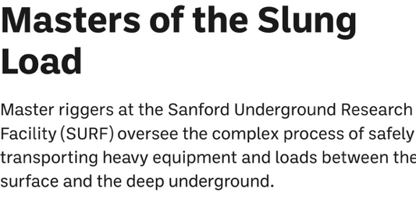
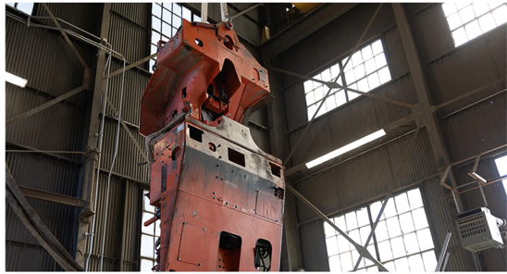
DUNE In the News

Slide 13

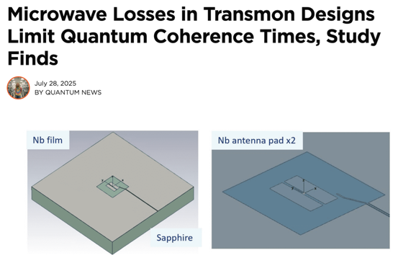

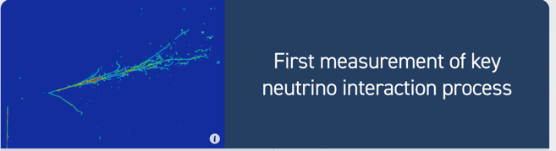




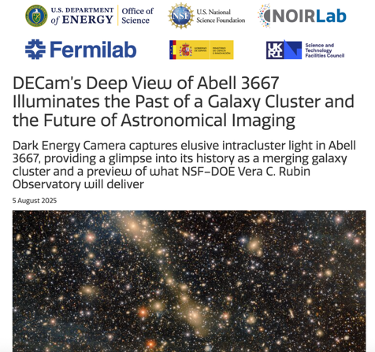
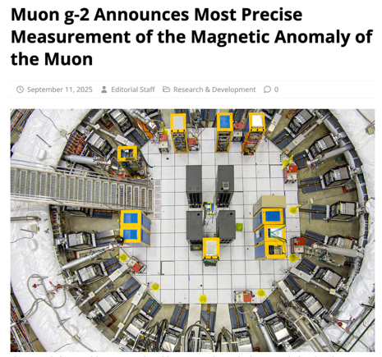
Science News

Slide 14



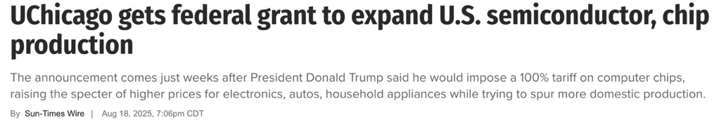

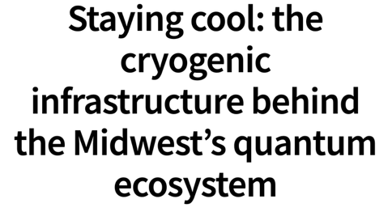

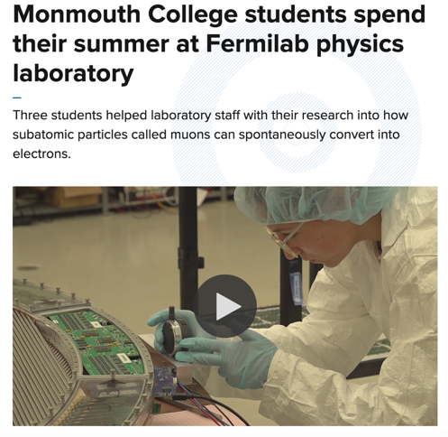
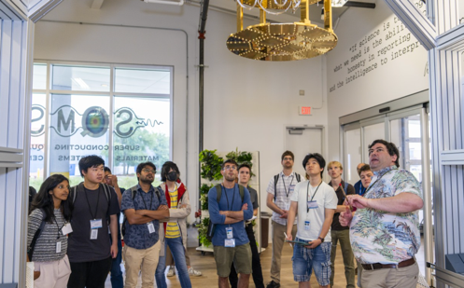
Partnerships

Slide 15


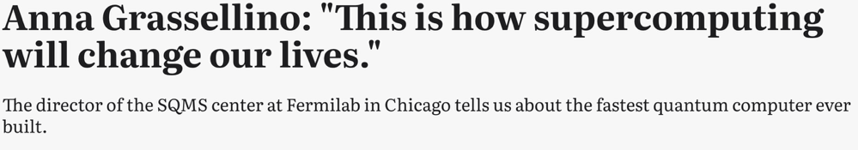


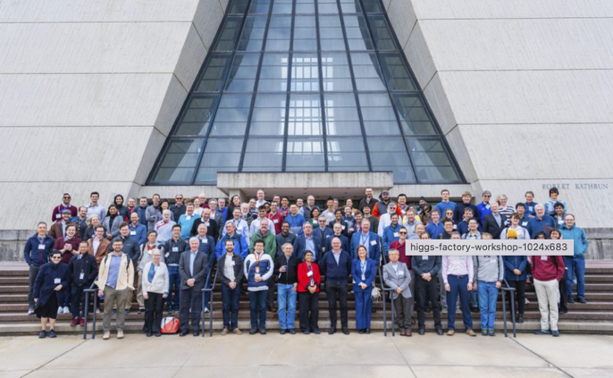
International coverage

