Slide 1
Update on Tritium Management at Fermilab
Presentation to Fermilab Community Advisory Board
Chris Greer, PhD
Chair, Tritium Task Force
Groundwater Manager, Environmental Protection Dept./ESH Division
January 26, 2023

Slide 2
Tritium and Environmental Monitoring at Fermilab
Fermilab has had an environmental monitoring program for about 50 years.
In 2005, the program detected for the first time tritium in surface water and in the sanitary sewer on the Fermilab site.
  We immediately informed the regulatory agencies, our neighbors and employees and the public.
Levels were, and continue to be, well below already conservatively protective regulatory limits.
  Highest level has been <20% of limit; the rest are <1% of limits
We strive to minimize tritium discharges, keep the public informed, and seek input on our plans and goals.
We have a Tritium Task Force that examines and implements improvements that we can make to reduce tritium levels
  The TTF includes accelerator and engineering experts as well as ES&H and DOE

Slide 3
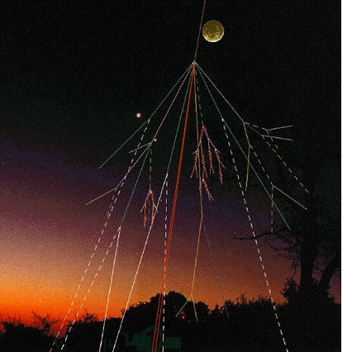
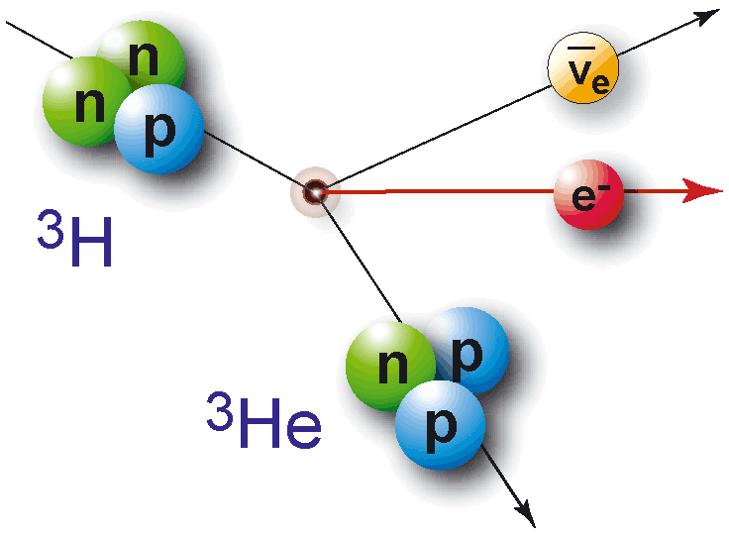
What is Tritium?
Tritium (³H ) is a weakly radioactive form of
hydrogen with a half-life of 12.3 years.
  In nature, tritium is produced when
  cosmic particles hit the atmosphere.
  Residual from nuclear tests (pre-1970s).
  At Fermilab and other particle accelerators, tritium is a byproduct of operation.
Its decay emits particles of very low energy that cannot penetrate the skin.
Tritium can only be harmful if people
drink water with high levels of tritium
over many years.
  Tritium does not build up in biological tissues; the biological half-life for tritiated water (HTO) is about 12 days.
Notes:
For skin penetration questions, refer to HPS (Health Physics Society) fact sheet on tritium: https://hps.org/documents/tritium_fact_sheet.pdf.

Slide 4
Where does Tritium come from at Accelerators?
High-energy protons hitting or traveling through materials produce tritium (³H).
  Typical materials used in experiments at Fermilab: iron, concrete, carbon, air, water, etc.
When protons or other particles hit nuclei in the atoms in materials, they “shatter” these nuclei into pieces.
  Some of the pieces left over are stable nuclei.
  Others are radionuclides, including tritium (³H) atoms.
Upon exposure to air, the ³H atoms combine with oxygen to make HTO molecules (tritiated water) with the same structure as H₂O (water).
  HTO “water” moves just like regular water.
  Fermilab monitors multiple water and air routes

Slide 5
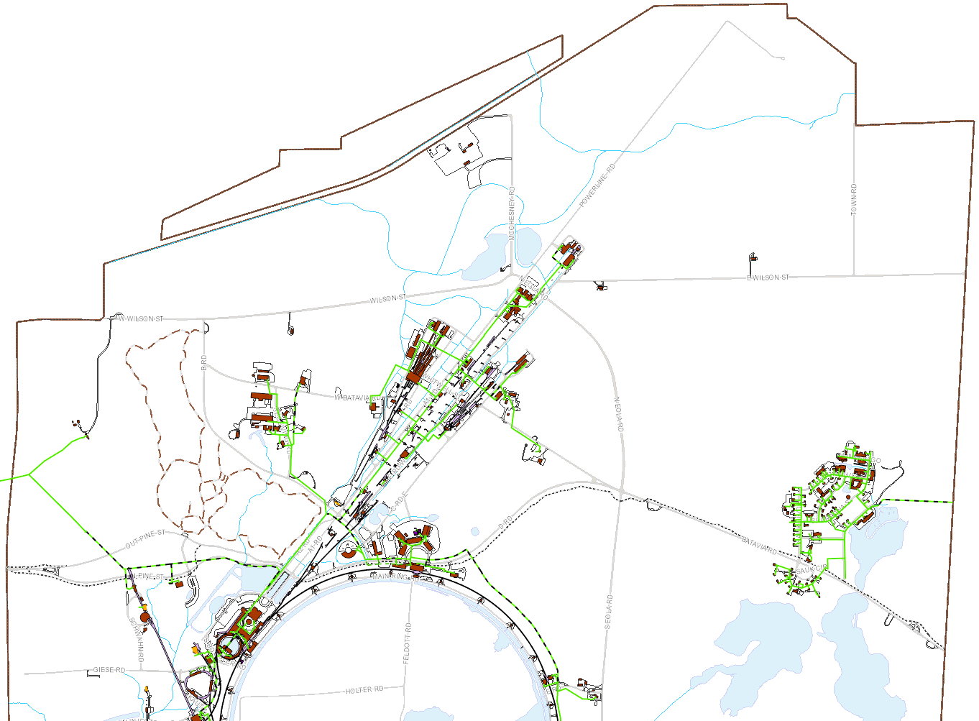
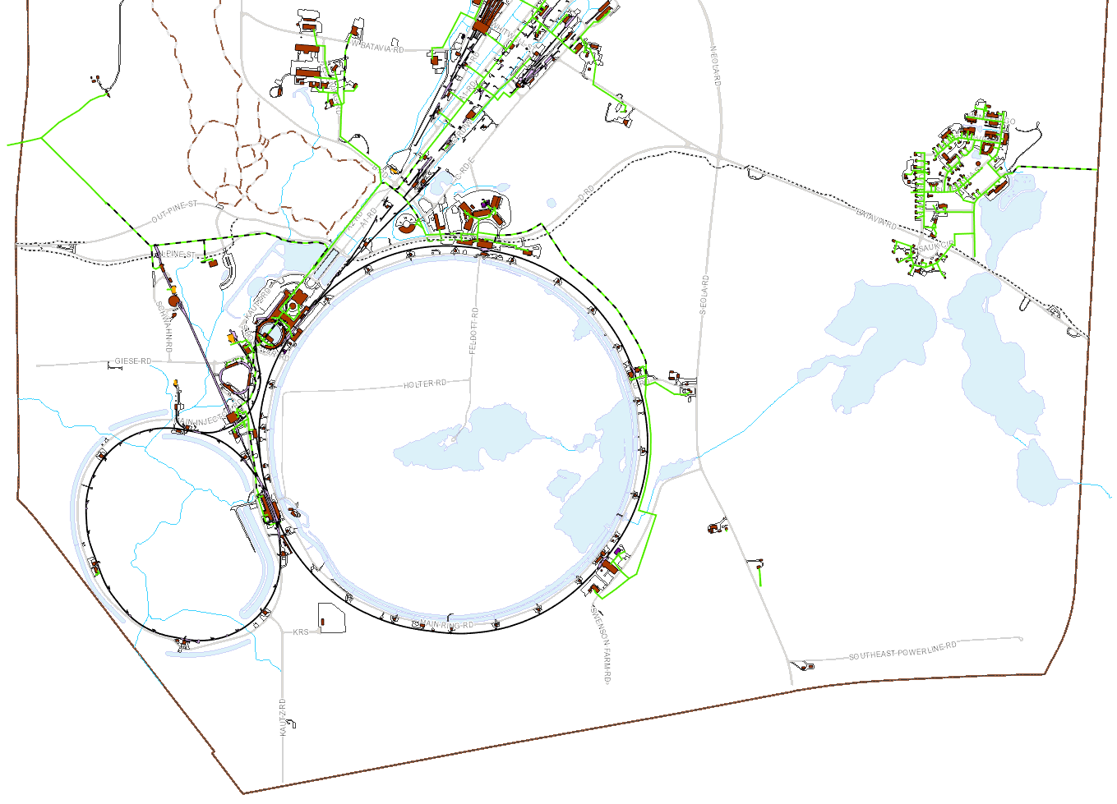
Tritium Discharges Relative to Regulatory Limits
2021 results as % of Limit:
Sanitary Sewer
  5 Ci in a year
Surface Water
  2,600 pCi/ml
Groundwater
  1 pCi/ml (Class 1 Resource Aquifer in bedrock)
Air
  0.1 mrem/year (all radionuclides)
Kress Creek
5.6%
0.16%
Background (4 wells)
Warrenville autosampler
SeaQuest
Batavia autosampler
Meson/Neutrino (5 wells)
Debonding Oven
Non-detect
EAV2/3
CUB
MI-12
AP-1
NuMI Target Hall (1 well)
MI-65 (2)
All APIs: 60%
Tritium: 0.9%
Ferry Creek
Indian Creek
MI-40

Slide 6
Standards for Surface and Drinking Water
DOE Surface water limit: 2,600 pCi/ml (picocuries per milliliter).
Federal limit for drinking water systems: 20 pCi/ml.
What do these standards mean?
1 picocurie (pCi) = 0.037 atoms decaying each second.
Threshold for measurement is usually taken to be 1 pCi/ml.
  A user of 2,600 pCi/ml water for their household water source full time would receive a radiation dose of 100 mrem each year.
  A user of 20 pCi/ml water for their household water source is assigned a dose of 4 mrem each year by U.S. EPA.
  Globally, rainwater is 0.16 to 0.32 pCi/ml due to cosmic rays and leftovers from nuclear weapons tests (ending in 1960s).

Slide 7
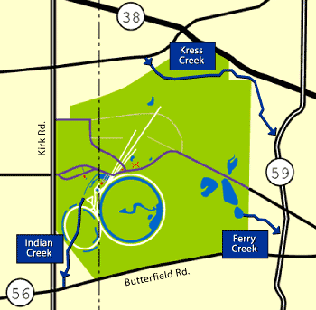
How Surface Water at Fermilab Connects to the Community
3 creeks leave Fermilab
  The Fermilab site has numerous ponds and is the origin of Indian Creek and Ferry Creek
Fermilab uses water to cool accelerators and other equipment
  Our pond system is part of an “industrial cooling water system” (ICW)
  ~250,000,000 gallons

Slide 8
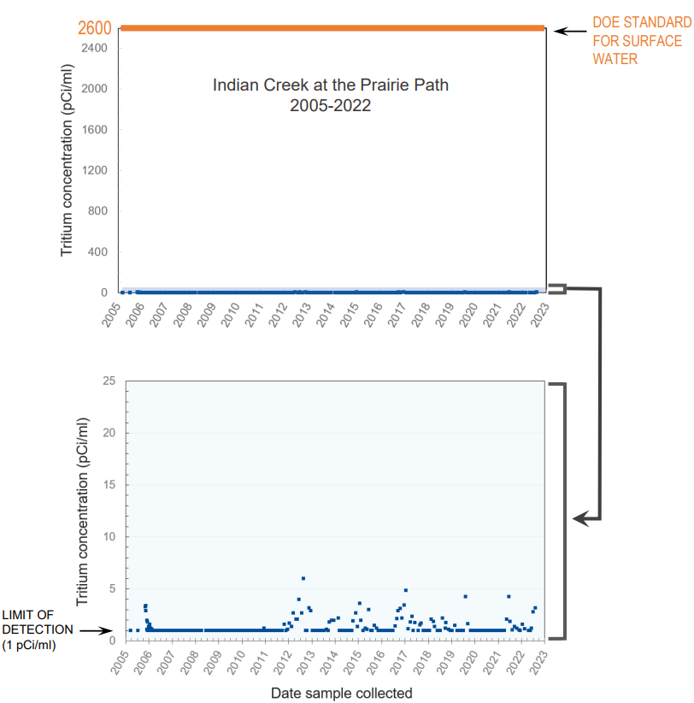
Surface Water Boundary Results: Indian Creek
<10 pCi/ml (usually <5 pCi/ml)
Regulatory limit: 2,600 pCi/ml
Non-detect (<1 pCi/ml)
USEPA Standard for Drinking Water
<2 pCi/ml (usually <1)
Data plots for all three creeks online at: https://www.fnal.gov/pub/tritium

Slide 9
Groundwater
We must protect Illinois Class I “Resource” Groundwater.
  Found in bedrock beneath Fermilab (60-90 feet deep).
  Must stay below 1 pCi/ml in Class I aquifers (i.e, those considered by Illinois to be “useful” for drinking water).
We design and operate our experiments so that any tritium produced stays out of groundwater.
  Fermilab employs a hydrogeologist on its staff as an advisor.
We have never found tritium in Class I groundwater.
  At least ten wells are sampled annually.
  More than 100 wells are measured annually to determine flow directions.

Slide 10
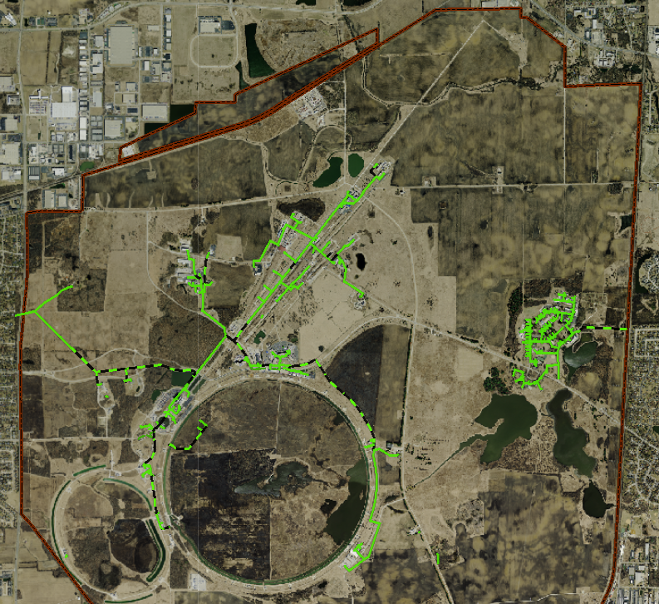
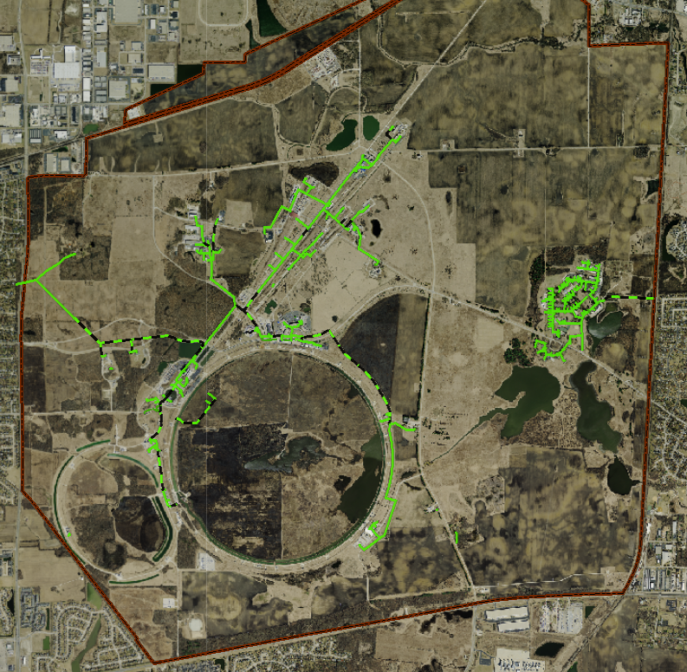
Monitoring Tritium in the Sanitary Sewer System
Composite Sampler
(to Batavia system)
Composite Sampler
(to Warrenville system)

Slide 11
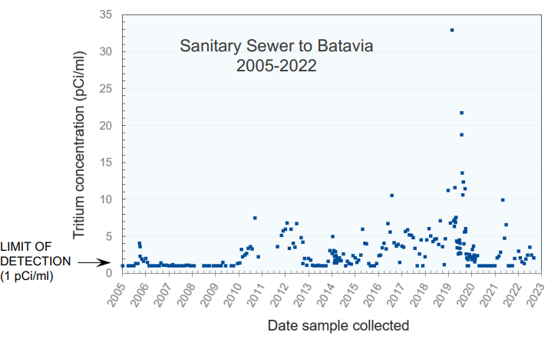
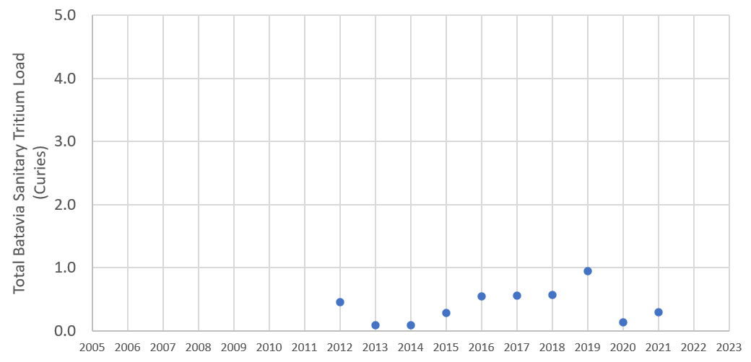
Sanitary Sewer Boundary Results: Batavia
<35 pCi/ml (usually <20 pCi/ml)
2021 annual total activity load was ~5.6% of 5 Ci annual limit
Data plot online at: https://www.fnal.gov/pub/tritium
Annual Discharge Limit to Batavia
2012-2021

Slide 12
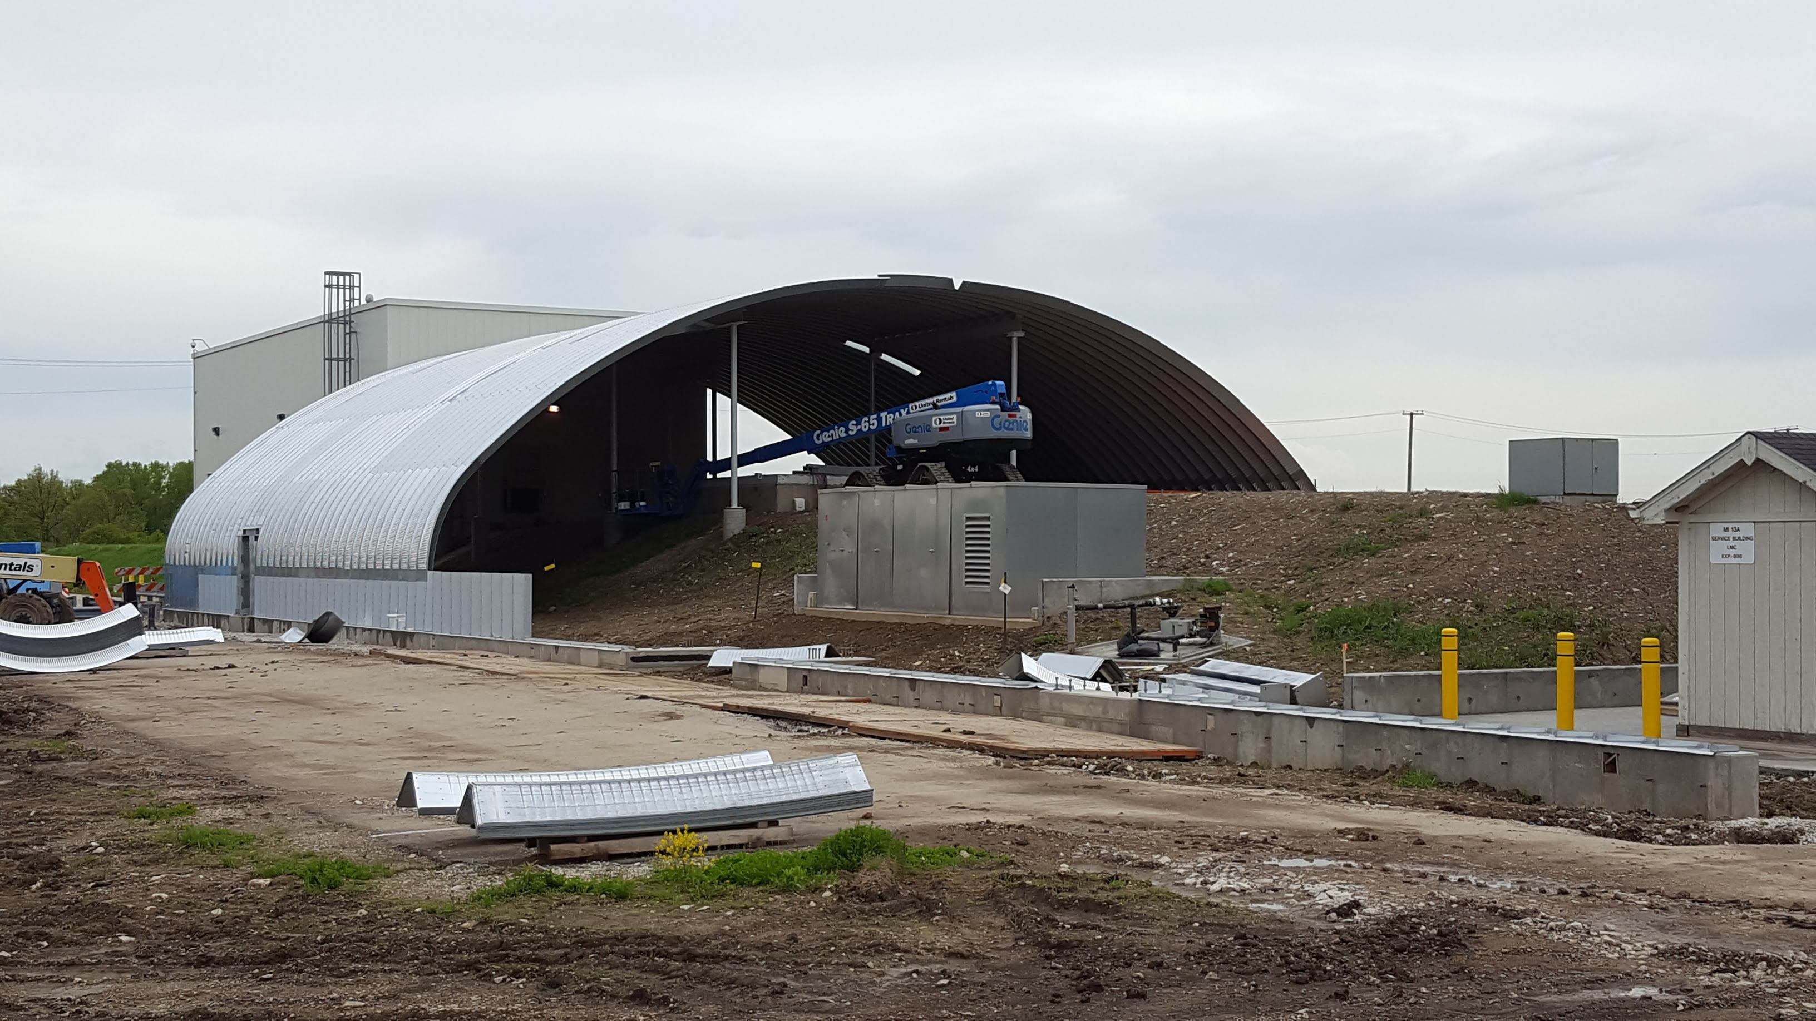
Recent Improvements
In 2019 we finished installation of a canopy and liner over the BNB berm, under which we produce neutrinos for on-site experiments
  Infiltration reduced by >90%, which means less HTO is produced
  First phase of shallow groundwater monitoring wells: all <1 pCi/ml
    Additional bedrock wells to be installed and added to sampling program

Slide 13
Recent Improvements
Hosted an external review of Fermilab tritium management
  Eight reviewers from five other labs (PNNL, LANL, SLAC, BNL and ORNL), including DOE Fermi Site Office input
  Commendations included: BNB canopy, applying lessons learned to LBNF design, public communication
  Recommendations included: expand automated and groundwater monitoring, elevate and expand tritium management and funding, contingency planning
Onsite data being added to public webpages
  Already implemented: summary of onsite pond results (Fact Sheet)
  In process: addition of state-reported NPDES permit data to surface water plots

Slide 14
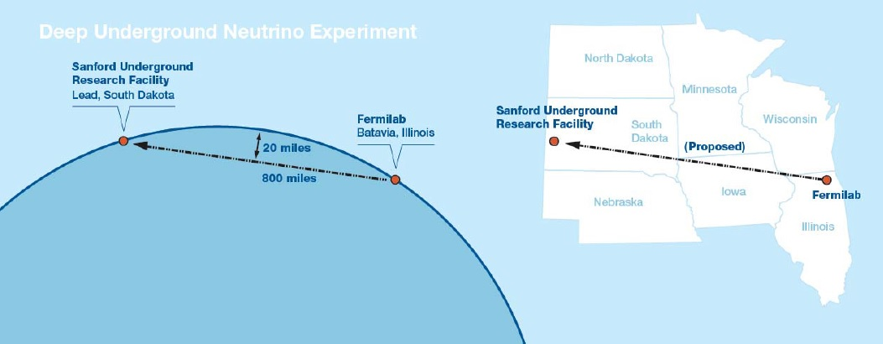
Future experiments: LBNF/DUNE
We are planning a new neutrino beamline at Fermilab to send a stream of neutrinos to the LBNF/DUNE experiment in South Dakota.
  This will be a new neutrino beam to operate after our neutrino experiment in Minnesota is retired.
Keeping the production of tritium well below regulatory limits is a major focus on the design of this new, higher beam power facility.

Slide 15
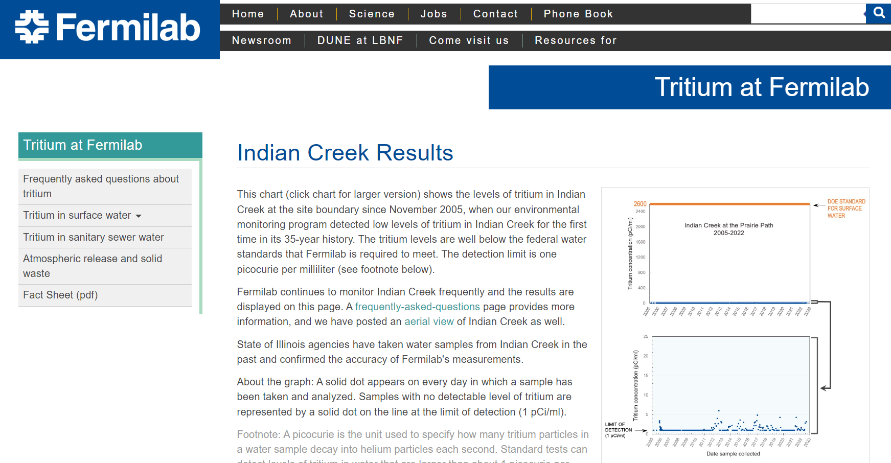
Keeping the Public Informed
We held Environmental Assessment meetings for LBNF/DUNE in 2015.
We inform you: the Community Advisory Board.
We update and post tritium data on our public tritium webpages.
Also publicly available:
  Annual environmental reports
  FESHM Chapters (Fermilab ESH Manual)
https://www.fnal.gov/pub/tritium/index.html

Slide 16
Questions for the CAB
Members of the Community Advisory Board are one of Fermilab’s connections to the community. As such, we’d like to know:
How should we keep the community informed and maintain a dialogue?
Are there specific groups or persons we should reach out to?
What questions and recommendations do you have?
We strive to be good stewards of the Fermilab site. Please let us know if you have concerns.

Slide 17
Additional Questions for Us?
…

