Slide 1
What’s new at Fermilab?
Office of Communication Kurt Riesselmann on behalf of Tracy Marc, media relations manager September 22, 2022

Slide 2
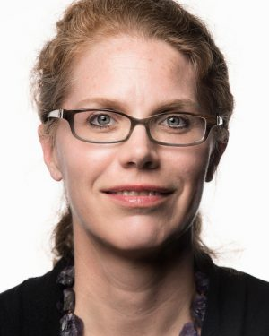
Bonnie Fleming joins Fermilab
Chief Research Officer and Deputy Director
Notes:
Bonnie Fleming has been named Fermilab’s chief research officer and deputy director responsible for leading all areas of science and technology, effective Sept. 6, 2022.
She has been a Fermilab user for many years and was on faculty at Yale University but has transitioned to the University of Chicago’s faculty as a professor of physics and the Enrico Fermi Institute, also effective Sept. 6.

Slide 3
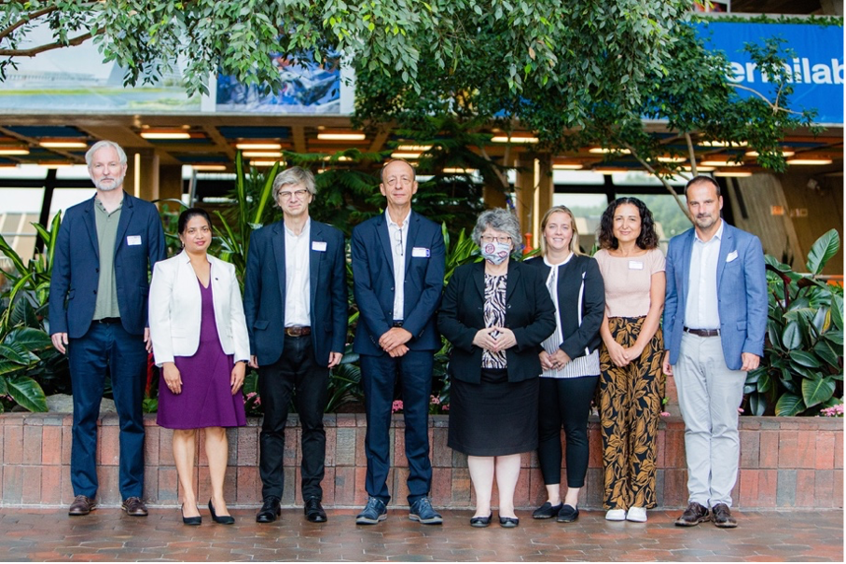
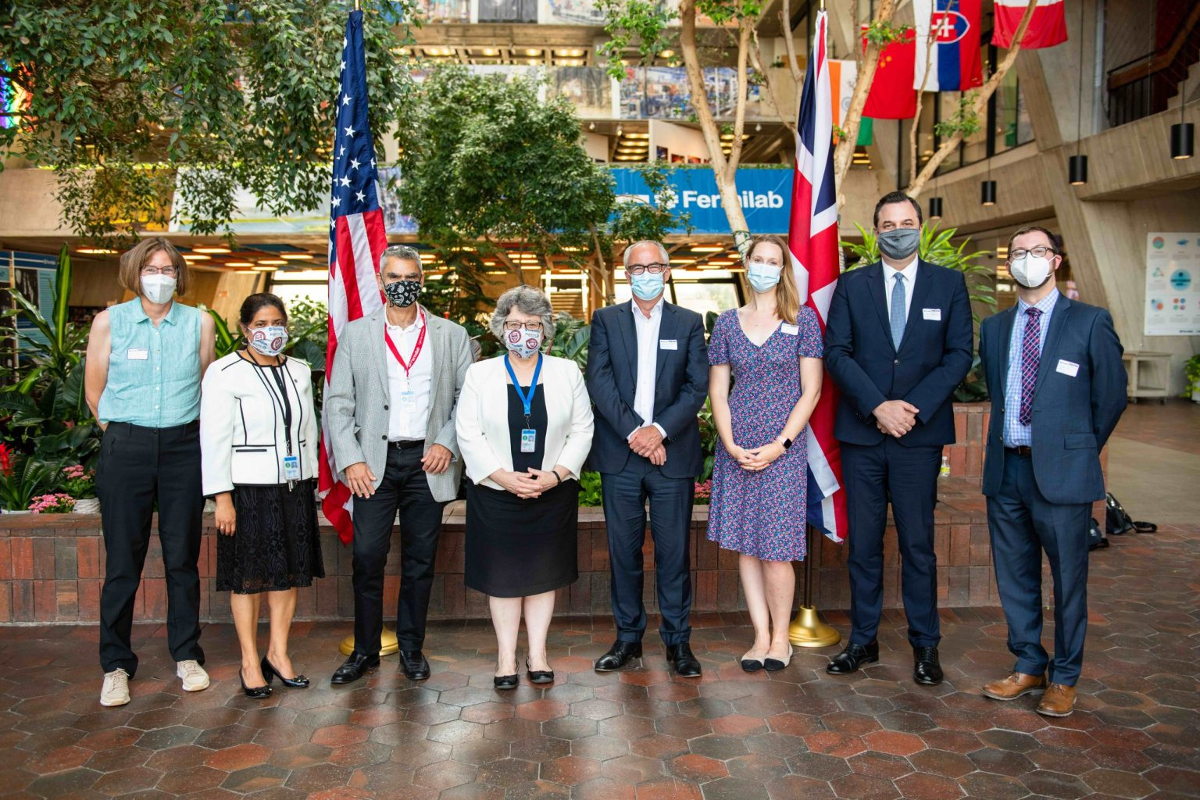
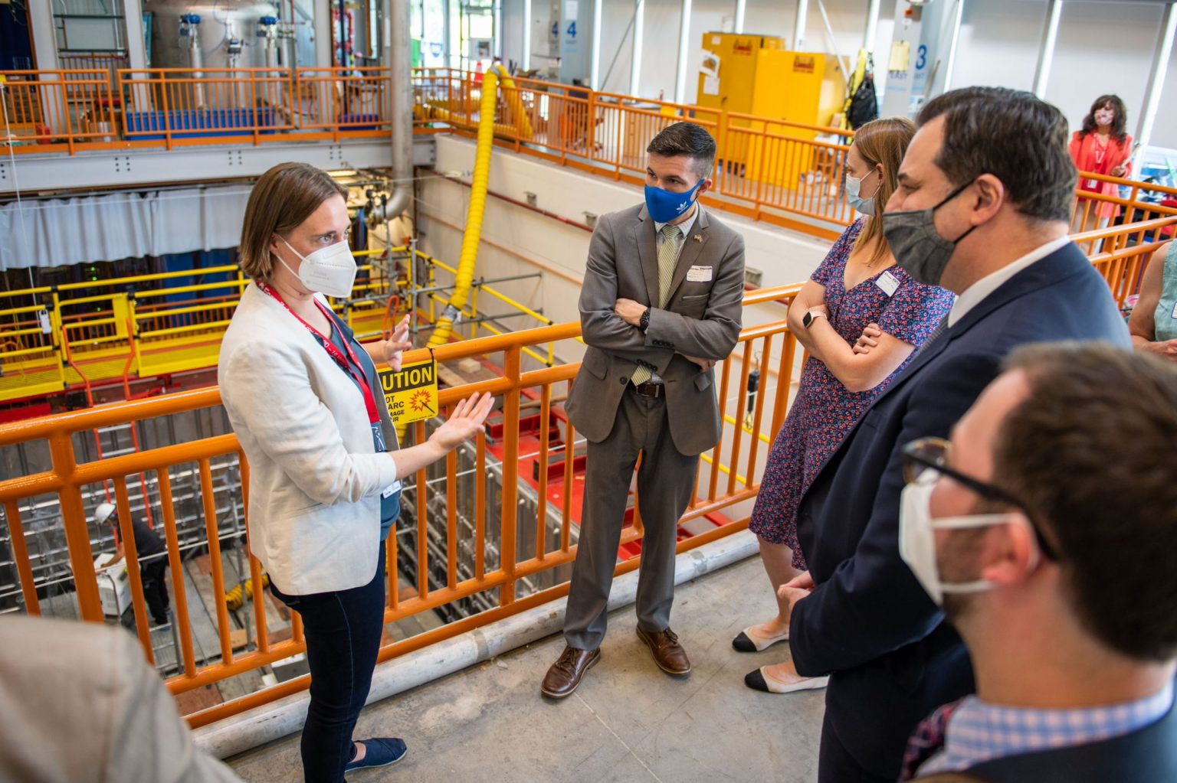
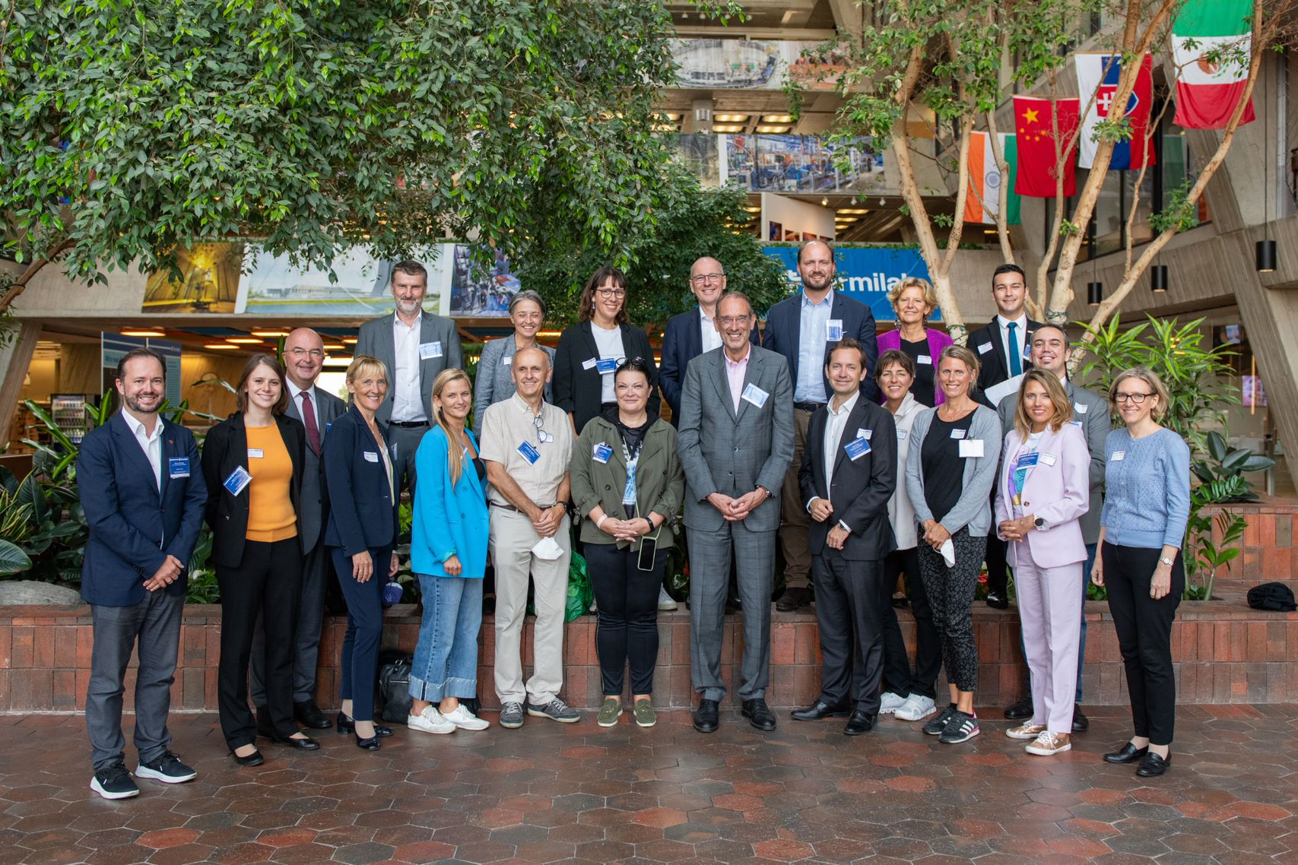
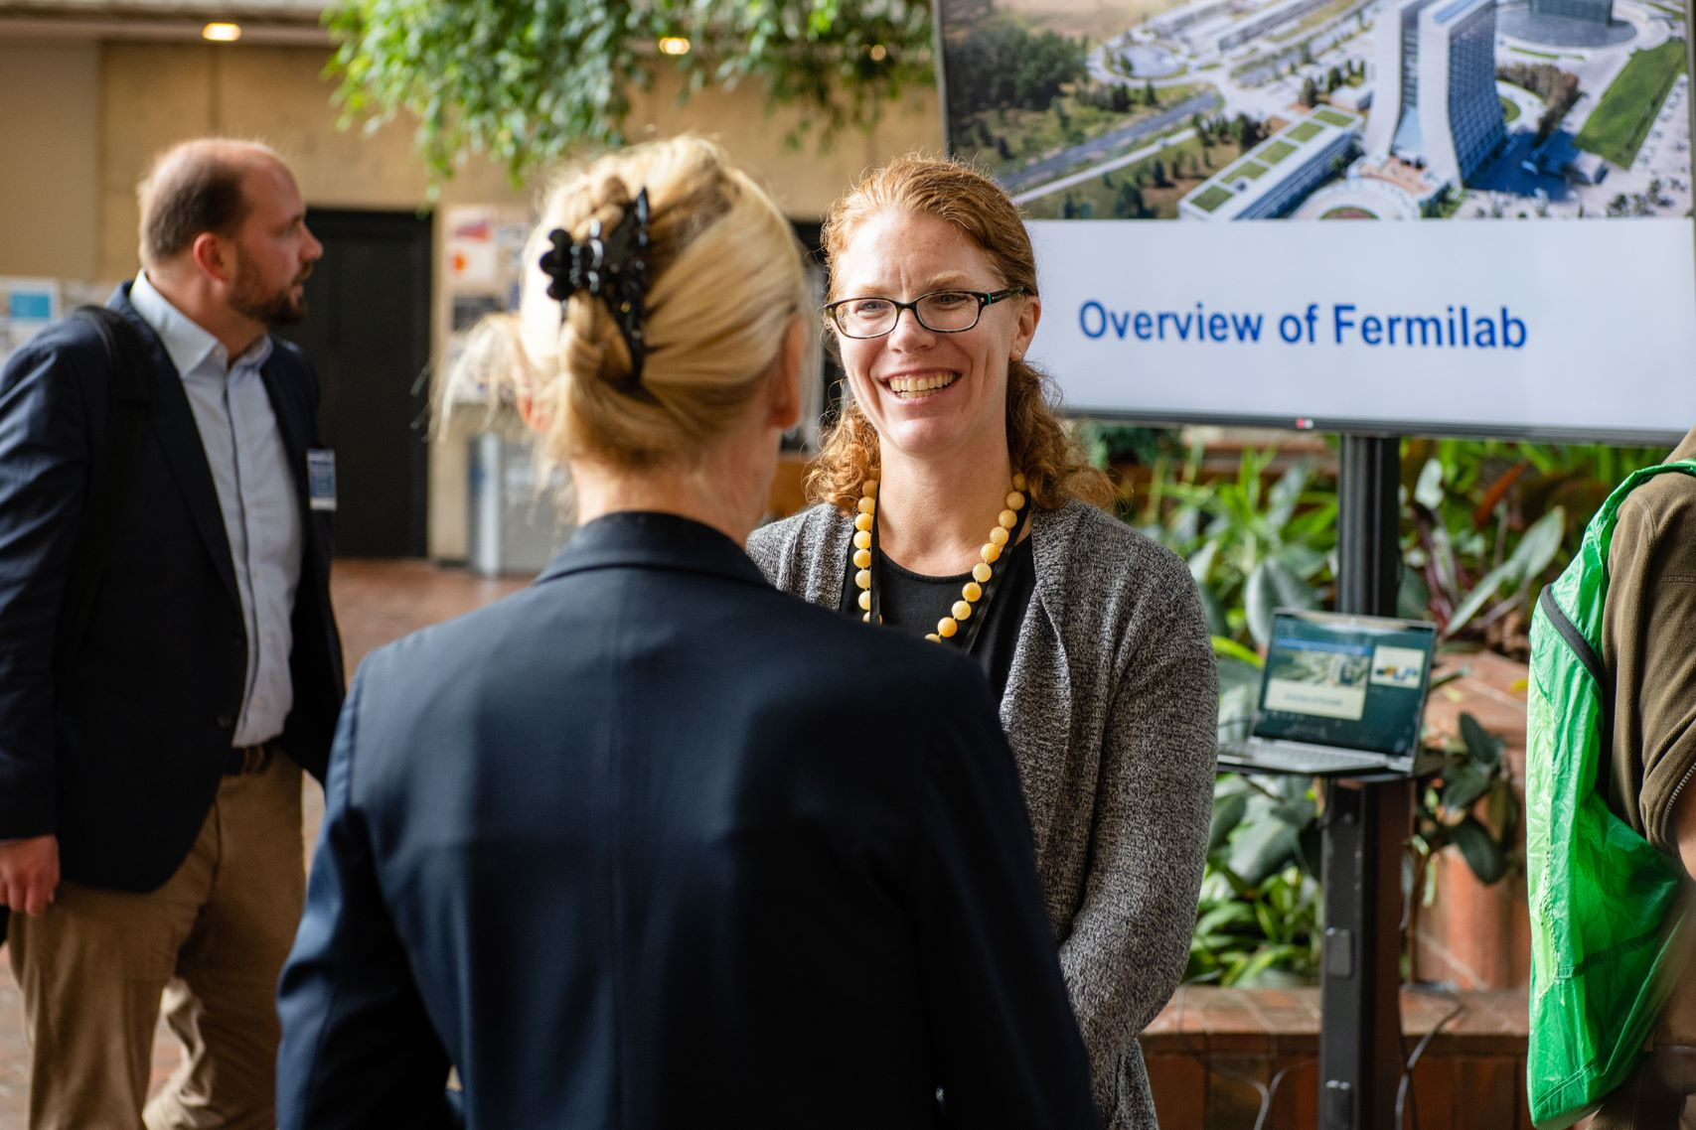
International visits
Delegations from the UK, France and Austria
Notes:
Fermilab welcomes British Consul General and UKRI-STFC delegation
August 24, 2022
Delegation from French national research institute IN2P3 visits Fermilab
September 2, 2022
Austrian science and research teams visit Fermilab (not yet posted)
September 16, 2022

Slide 4
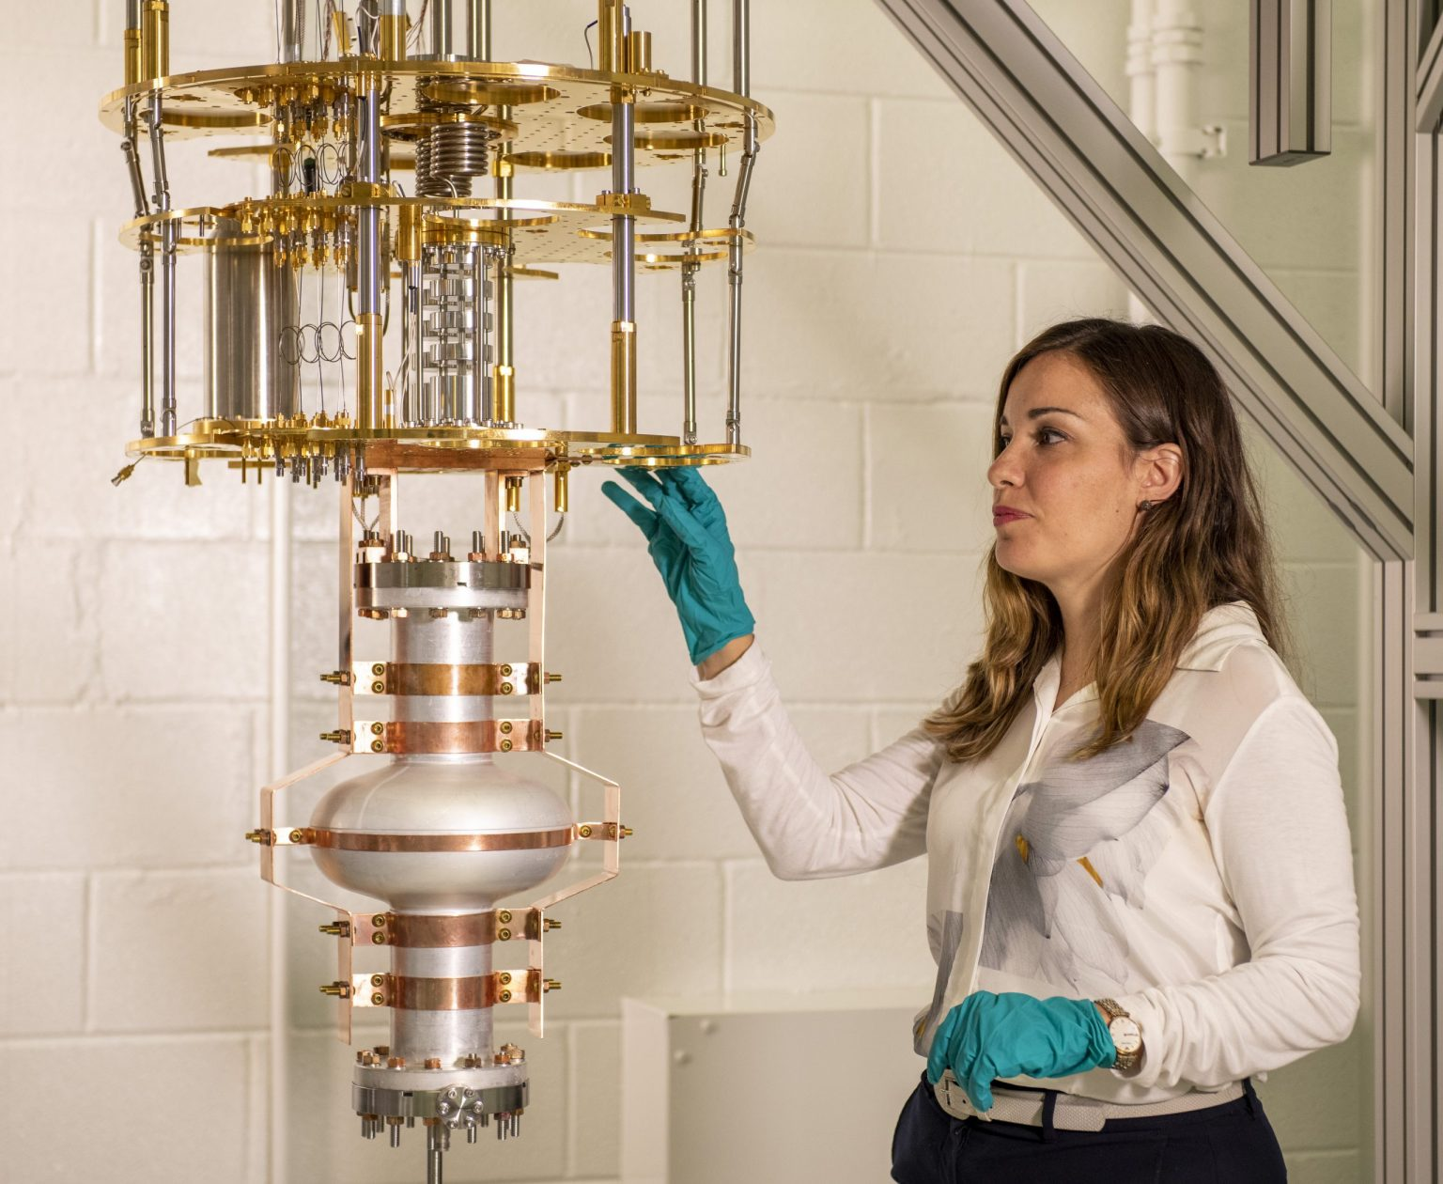
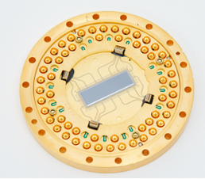
Quantum update
A superconducting-based quantum processor, composed of several thin film materials deposited on top of a silicon substrate.
Photo: Rigetti Computing
SQMS Center researcher Silvia Zorzetti inspects a dilution refrigerator set with a single cavity. Photo: Ryan Postel, Fermilab
New result: silicon seems to limit the performance of superconducting quantum processors
Notes:
New measurements point to silicon as a major contributor to performance limitations in superconducting quantum processors
Scientists at the SQMS Center have directly probed silicon’s impact on the lifespan of superconducting qubits. The uniquely sensitive measurement helped researchers quantify how the material impacts qubit performance.
How the Five National Quantum Information Science Research Centers harness the quantum revolution
Five National Quantum Information Science Research Centers are leveraging the behavior of nature at the smallest scales to develop technologies for science’s most complex problems

Slide 5
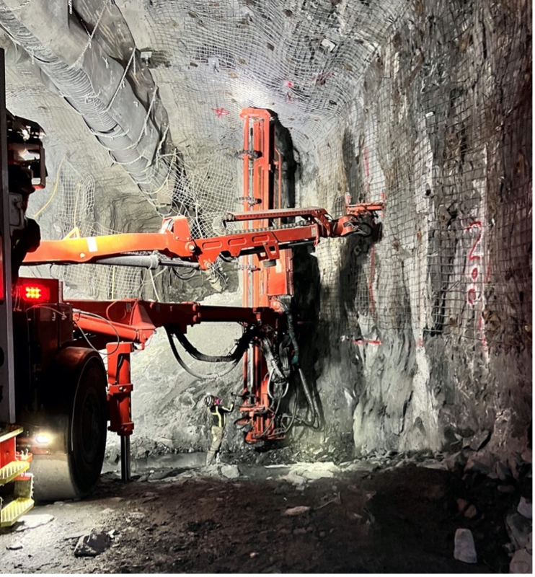
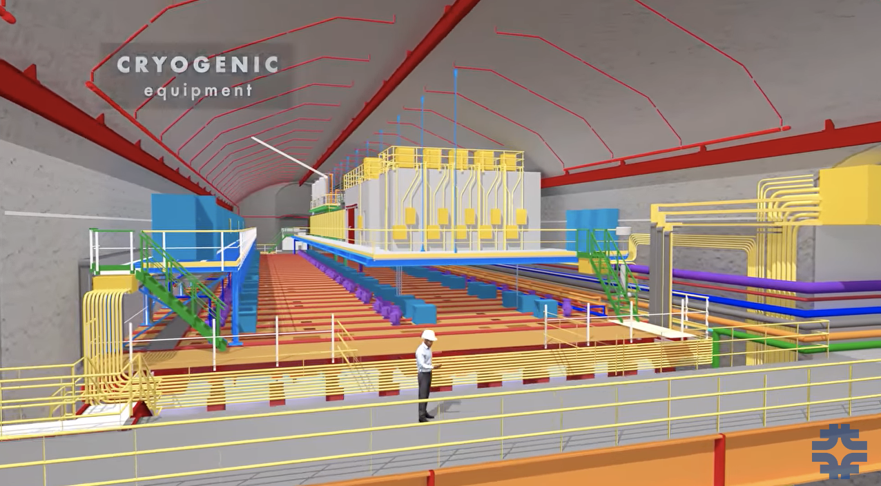
DUNE update
Excavation in South Dakota is 40 percent complete
Notes:
Excavation of huge caverns for DUNE particle detector is underway –
Excavation of the large caverns for the Long-Baseline Neutrino Facility is in full swing. Over a third of the whopping 800,000 tons that need to be extracted from a mile underground have been removed. When finished, the underground facility will cover an area about the size of eight soccer fields and provide space for the international Deep Underground Neutrino Experiment.
Video on YouTube-A mile underground: the large caverns and detectors of DUNE
New drone footage animations developed to illustrate the magnitude of the caverns and underground facility.

Slide 6
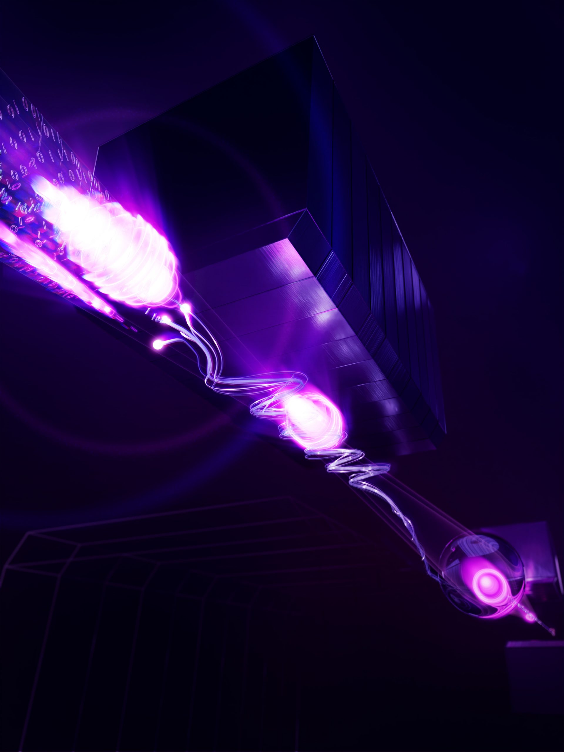
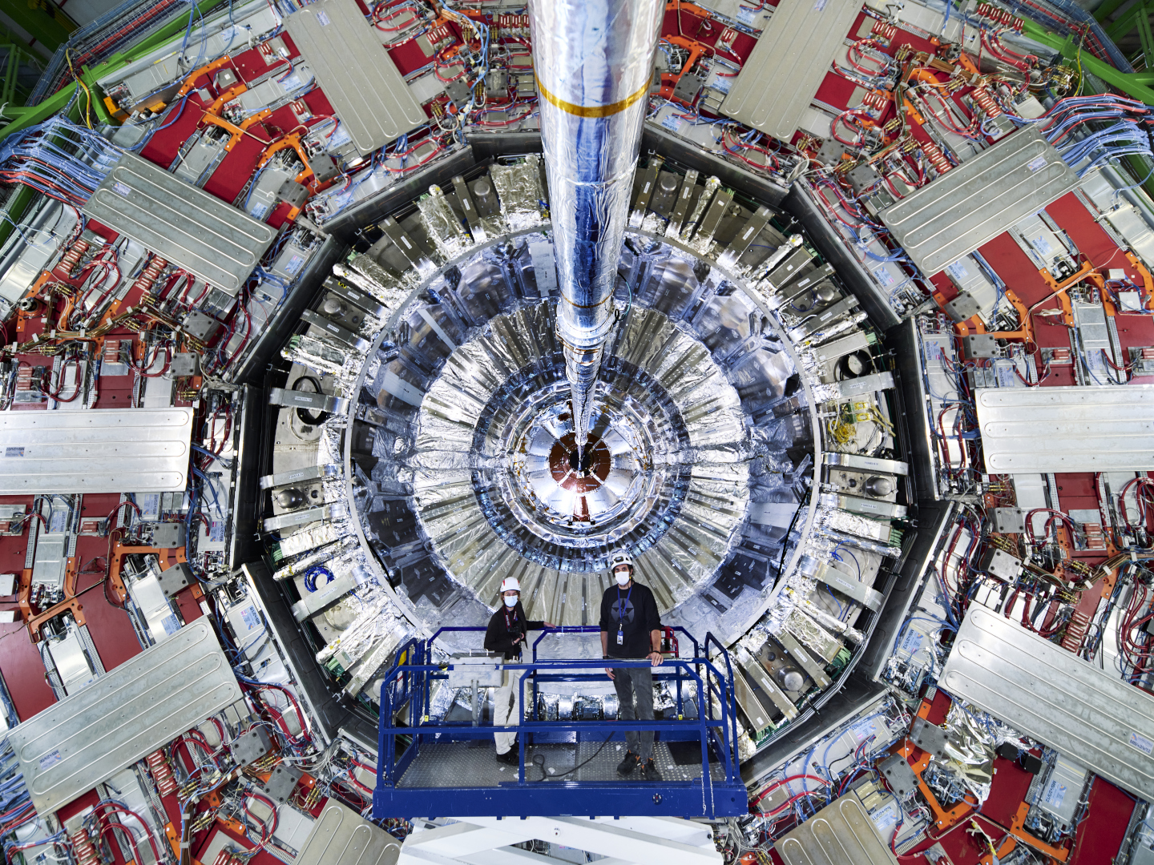
Science news
The CMS detector at CERN. Photo: Samuel Joseph Hertzog, CERN
Beam particles emitting ultrafast light pulses as they pass through a special magnet to capture information about each particle’s energy or trajectory. Image: Jonathan Jarvis, Fermilab
Notes:
First demonstration of a new particle beam technology at Fermilab
Fermilab researchers announced the first successful demonstration of a new technique that improves particle beams. Future particle accelerators could potentially use the method to create better, denser particle beams, increasing the number of collisions and giving researchers a better chance to explore rare physics phenomena that help us understand our universe. The team published its findings in a recent edition of Nature.
Preparing for a more powerful particle accelerator
While the The Large Hadron Collider at CERN is back in action, researchers continue to prepare for the next iteration of the LHC.
In the coming years, scientists will begin operating with an upgraded accelerator for the High-Luminosity LHC, which will collide more protons with more luminosity than ever before.

Slide 7
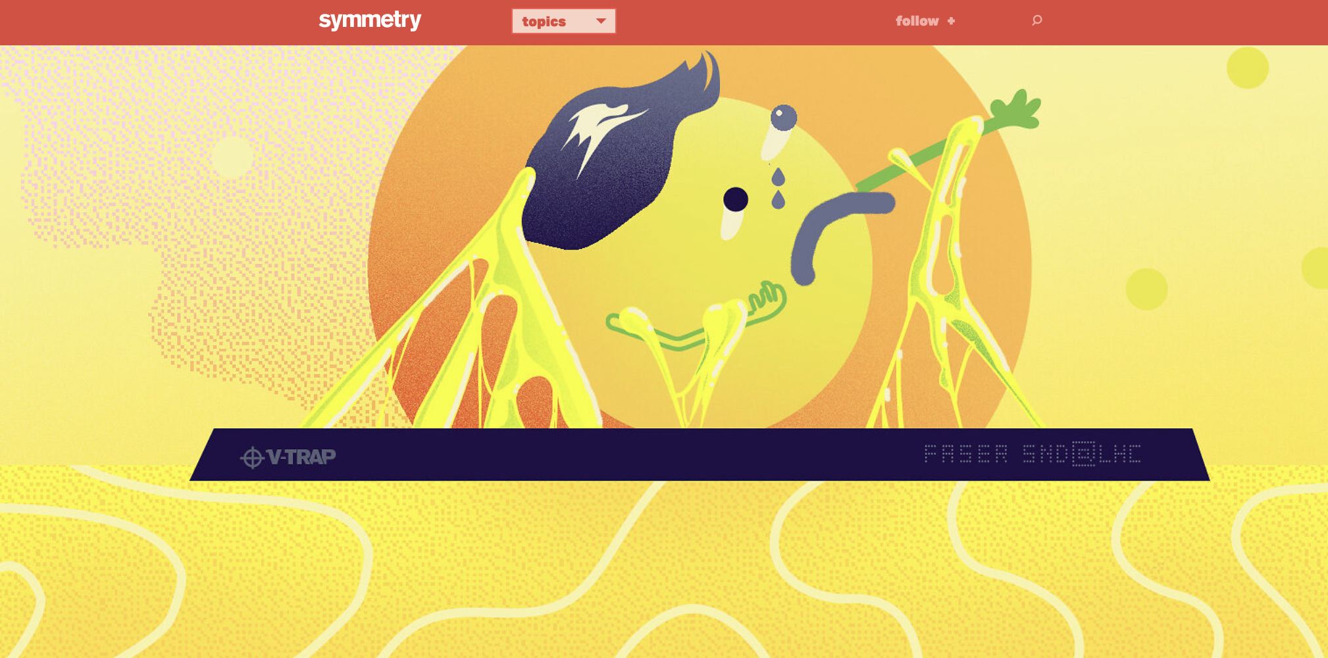
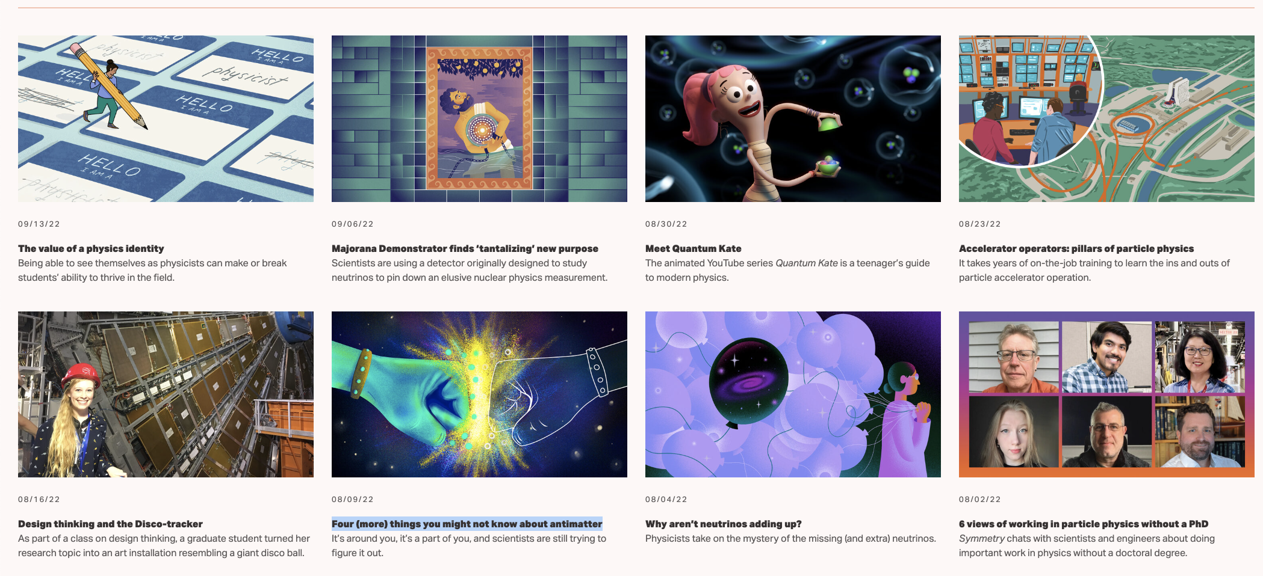
New stories in
Notes:
Recent issues include the following:
Catching neutrinos at the LHC
The value of a physics identity
Majorana Demonstrator finds ‘tantalizing’ new purpose
Meet Quantum Kate
Accelerator operators: pillars of particle physics
Design thinking and the Disco-tracker
Four (more) things you might not know about antimatter
Why aren’t neutrinos adding up?
6 views of working in particle physics without a PhD

Slide 8
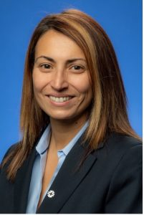
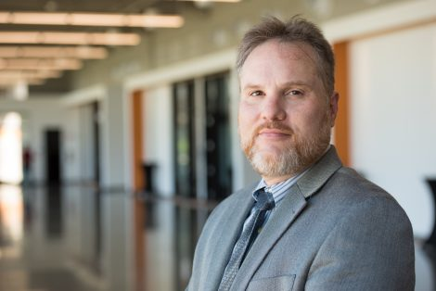
The People of Fermilab
Roger Snyder named manager of the DOE Fermi Site Office
Anna Grassellino
awarded a Breakthrough Prize in fundamental physics
Notes:
Anna Grassellino awarded a Breakthrough Prize in fundamental physics
This morning it was announced Dr. Grassellino received a 2023 New Horizons in Physics Prize as a researcher for her work and impact in the particle accelerator technology and quantum science fields. She will receive $100K to apply towards her research.
Roger Snyder becomes permanent DOE site office manager at Fermilab
As the representative of Department of Energy Office of Science at Fermilab, Snyder will continue to support the lab’s mission and ensure work is accomplished safely and within DOE requirements. The Fermilab acting site office manager since February, Snyder has been permanently reassigned to lead the Fermi Site Office while also serving as acting site office manager for nearby Argonne Laboratory.

Slide 9
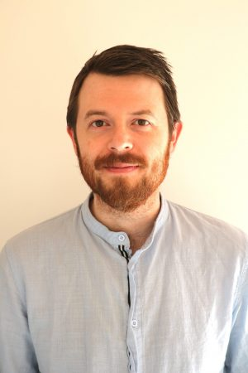
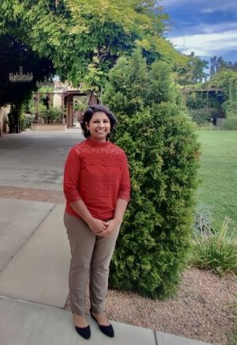
The People of Fermilab – profiles
Timm Hobbs, theoretical physicist
Sajini Wijethunga, accelerator scientist
Notes:
A minute with Tim Hobbs, theoretical physicist
Tim performs theory calculations that are relevant for neutrino nuclear cross sections and understanding aspects of those calculations in greater detail and in preparation for the DUNE program.
A minute with Sajini Wijethunga, PIP-II postdoctoral researcher
She is investigating the electron cloud existence: whether there is an electron cloud present in the Booster and if so, whether it would impact the PIP-II-era Booster — because PIP-II requires an intensity upgrade in the Booster.

Slide 10
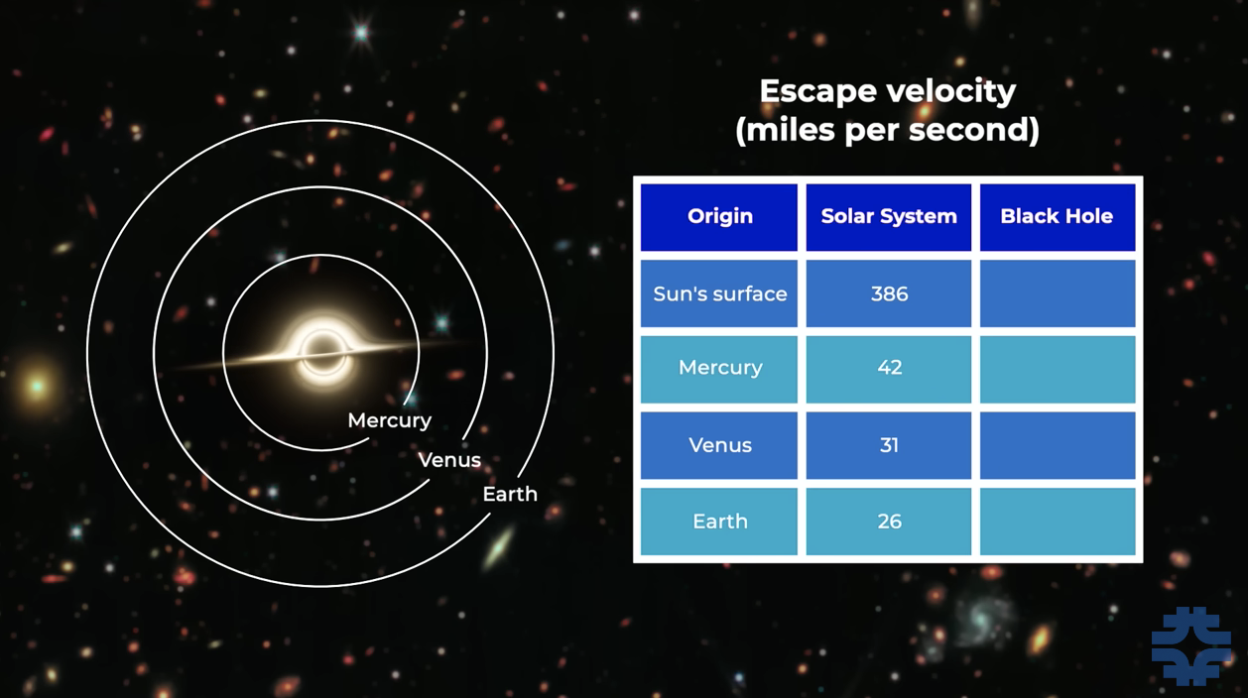
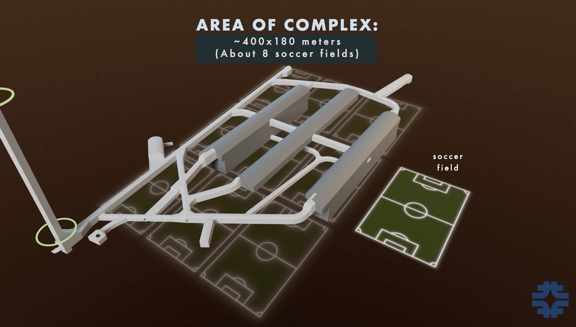
New Fermilab videos on YouTube
Notes:
New videos posted: Fermilab’s YouTube channel surpassed 670,000 subscribers
Don Lincoln – Sept. 2-What are Black Holes?
Fermilab’s Dr. Don Lincoln debunk some common misconceptions about black holes and also explains some important truths.
A repeat from previous DUNE slide: DUNE video posted August 15
New drone footage animations developed to illustrate the magnitude of the caverns and underground facility.

Slide 11
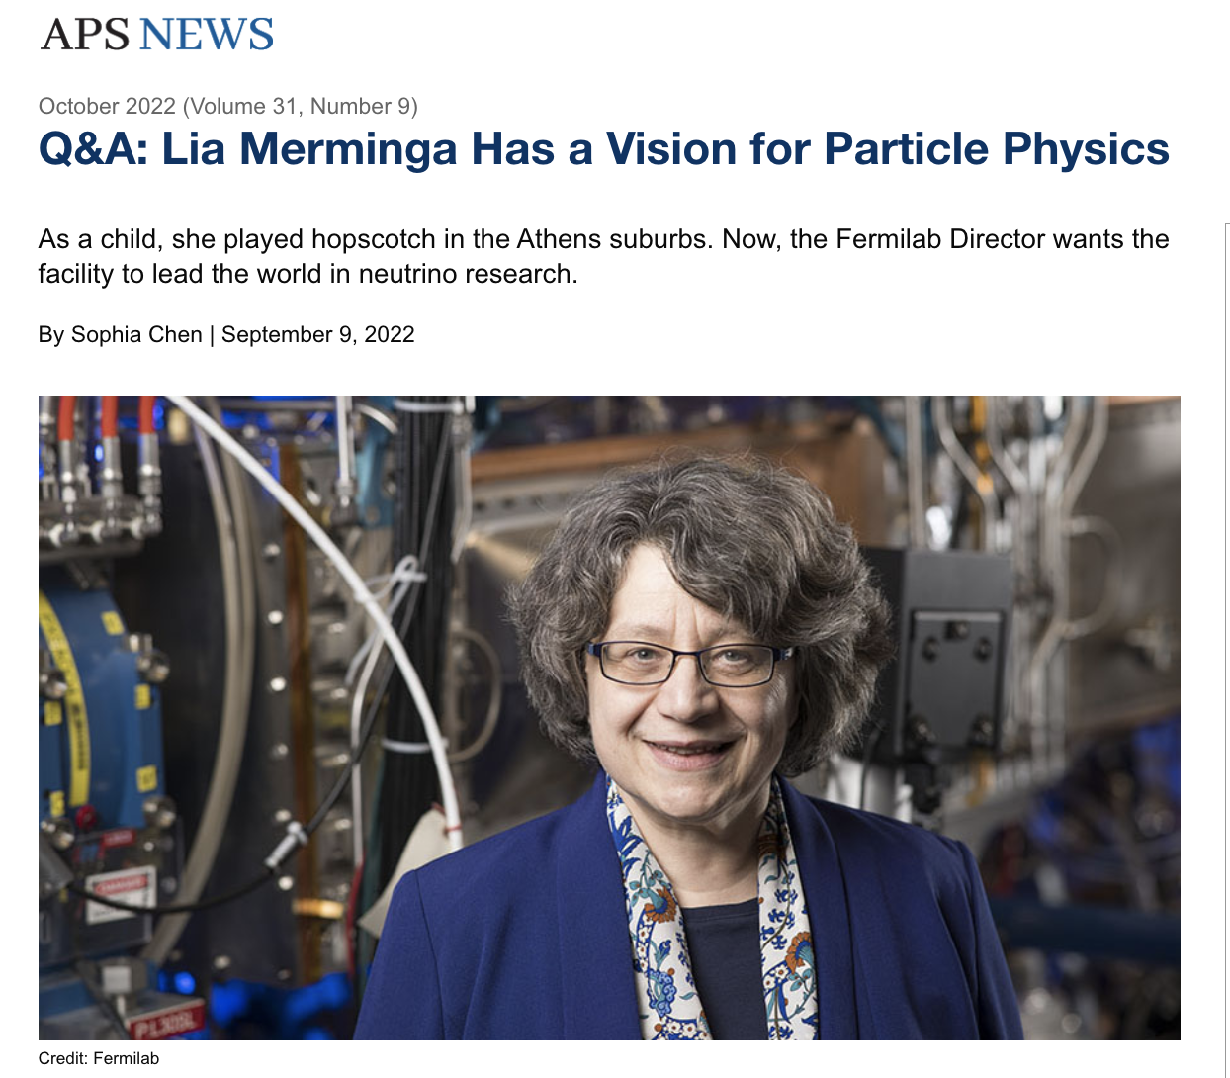
Fermilab in the news
Notes:
Just how big is the Universe? We still don’t know
From the Big Think, September 20, 2022
Q&A: Lia Merminga has a vision for particle physics
From the American Physics Society, September 14, 2022:

Slide 12
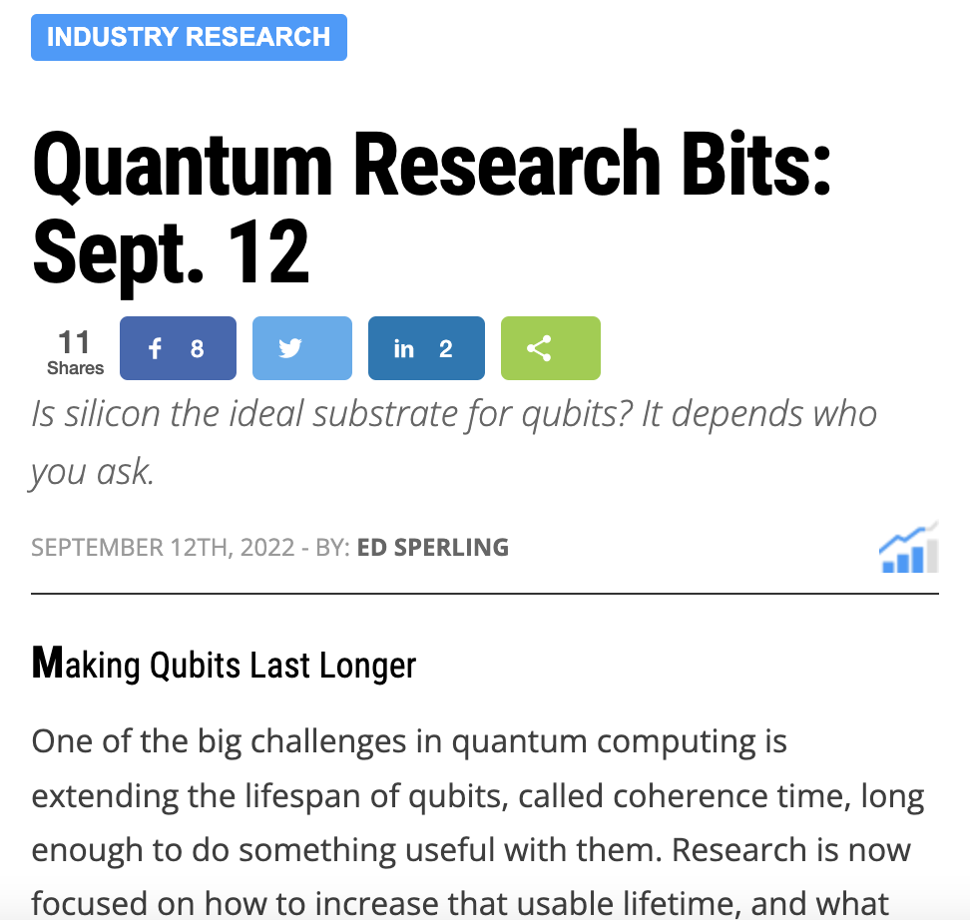
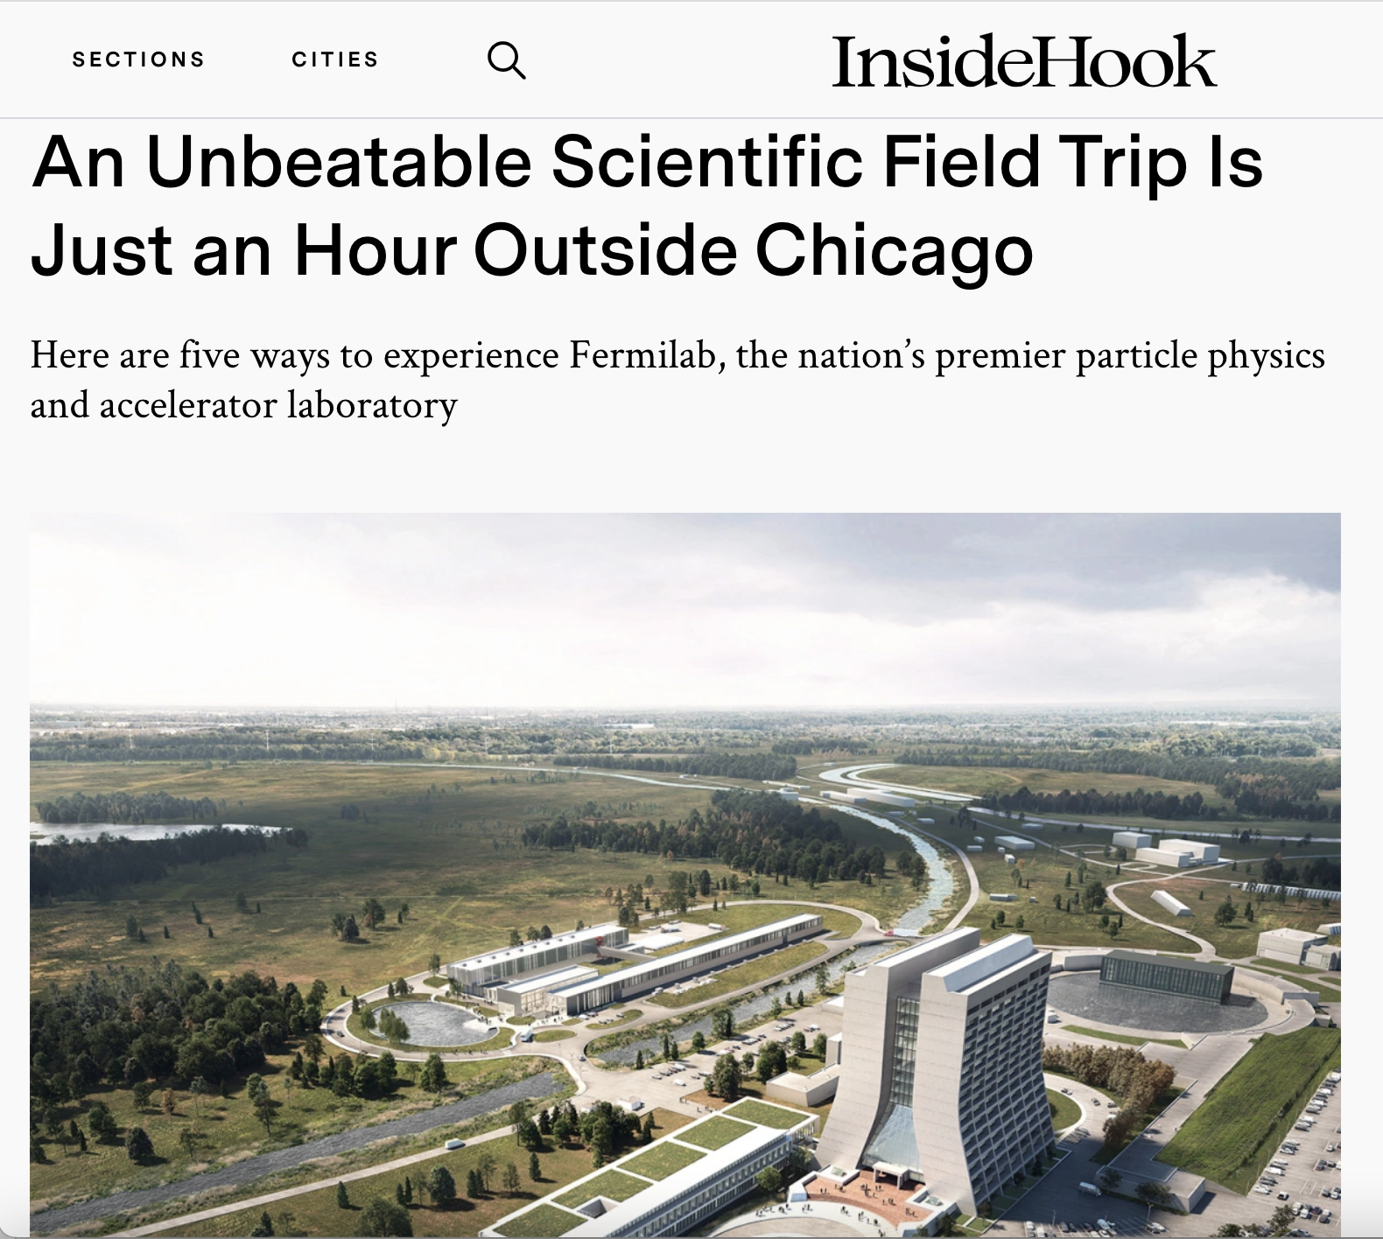
Fermilab in the news
Notes:
An unbeatable scientific field trip is just an hour outside Chicago
From Inside Hook, September 13, 2022: Inside Hook explores the science and public event opportunities at Fermilab. From cutting-edge experiments, to art, nature and the Lederman Science Center, Fermilab is a fantastic destination for Chicagoland area residents and visitors.
Quantum Research Bits: Is silicon the ideal substrate for qubits? It depends who you ask.
From Semiconducting Engineering, September 12, 2022

Slide 13
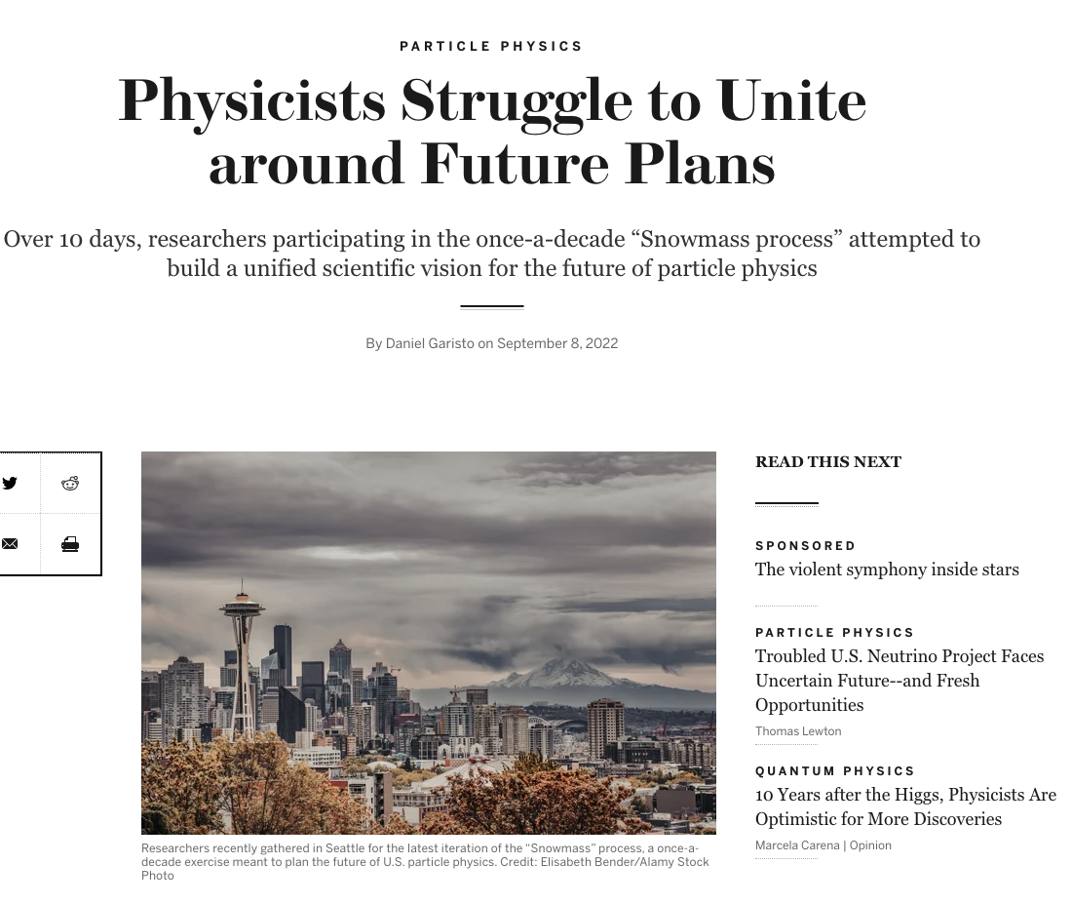
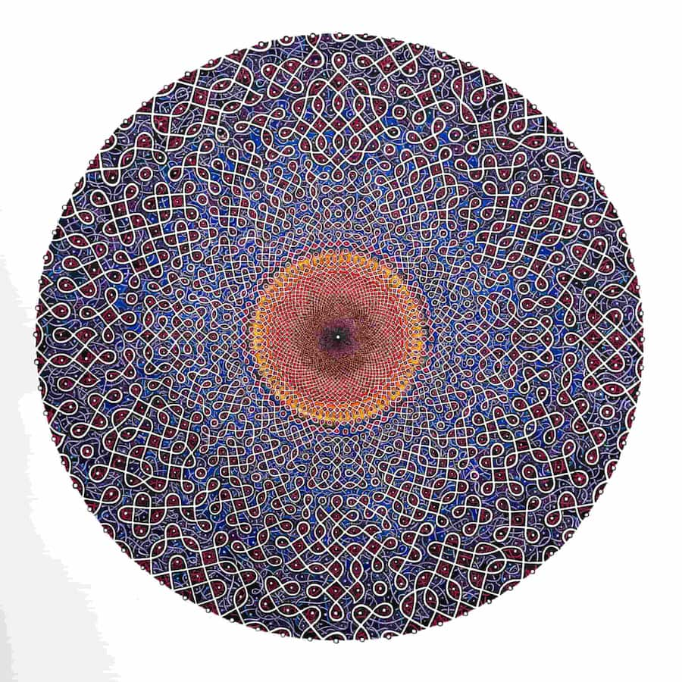
Fermilab in the news
Notes:
Physicists Struggle to Unite Around Future Plans
From Scientific American, September 8, 2022:
What came out of Snowmass 2022? In late July, nearly 800 particle physicists met for over 10 days for the once-a-decade Snowmass process to discuss and build a unified scientific vision for the future of particle physics. Find out what Fermilab director Lia Merminga presented and more about discussions around DUNE, diversity, SUSY, the LHC, future colliders and more.
Singularities and Infinities
From American University, September 6, 2022:
Four years ago, artist Shanthi Chandrasekar exhibited at Fermilab which led to a collaboration with Michael Albrow at the American University in Washington, DC. From September 10 – December 11, 2022, Singularities and Infinities will be on display and is a juxtaposition of art and science. Together Shanthi Chandrasekar, an artist trying to capture the intricacies and wonders of the Universe, and Michael Albrow, an experimental physicist and science writer, seek to explain in a few words the science behind the workings of the Universe.

Slide 14
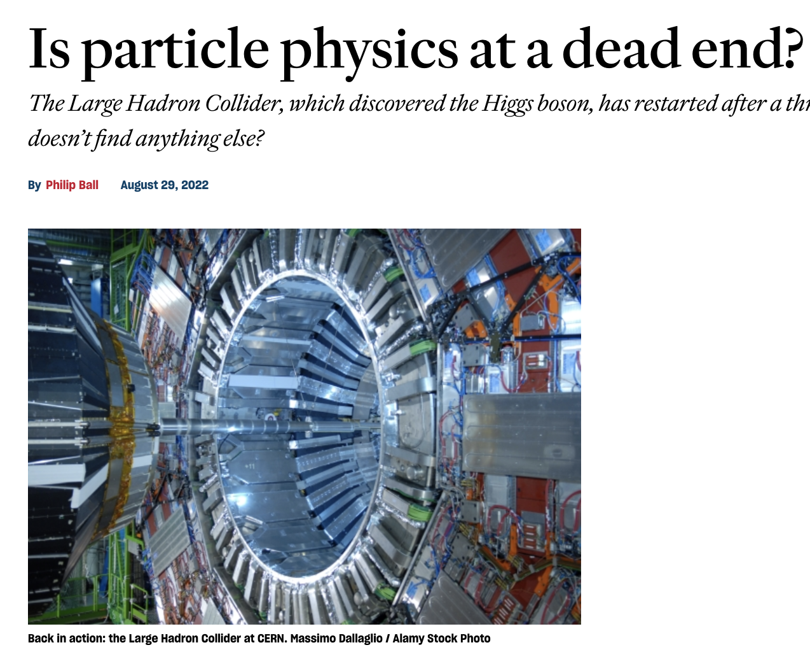
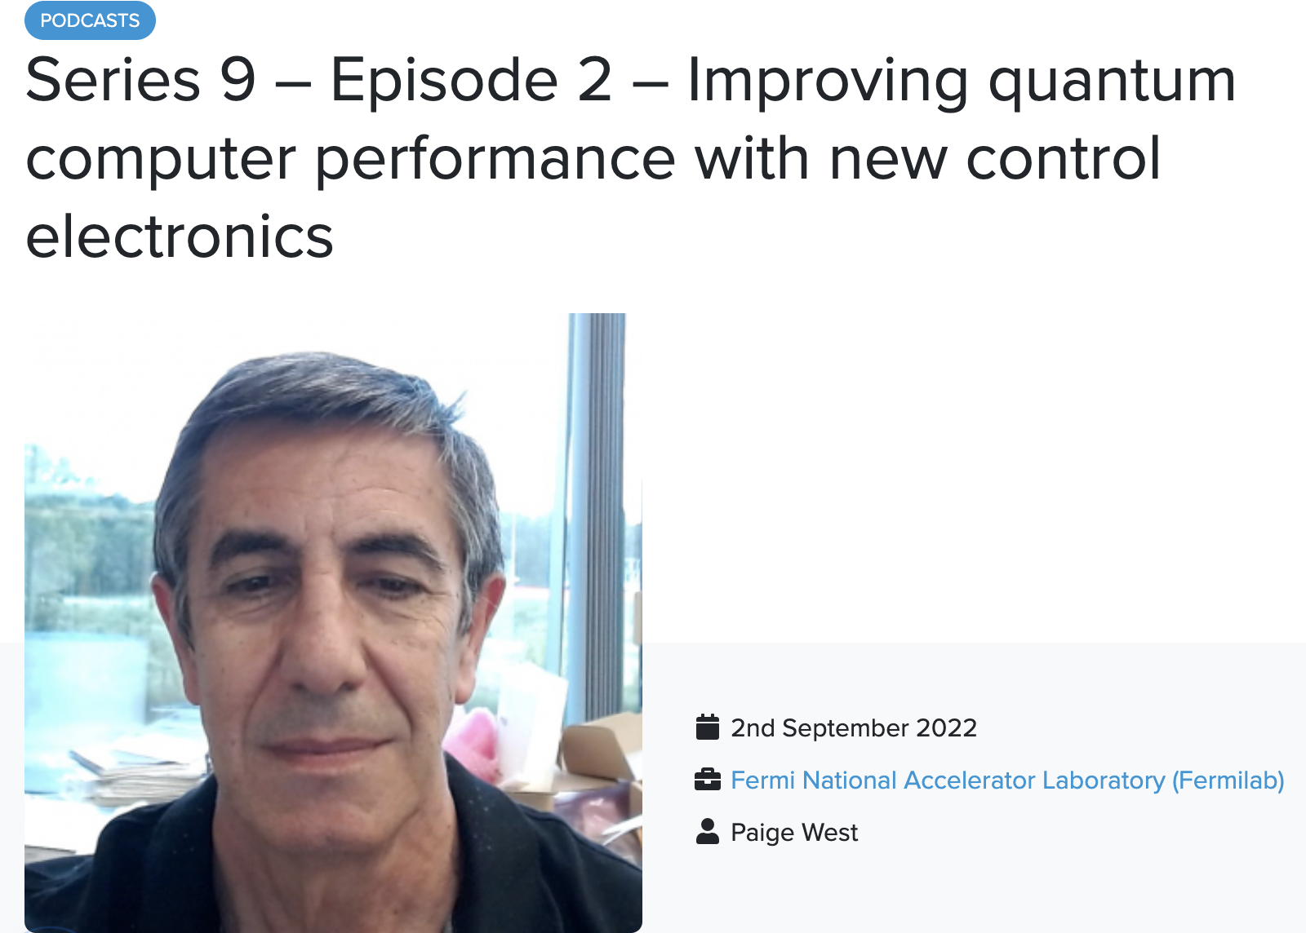
Fermilab in the news
Notes:
Improving quantum computer performance with new control electronics
From Electronic Specifier, September 2, 2022:
Electronic Specifier’s podcast talks with Gustavo Cancelo, Lead Engineer at Fermilab about a project that is developing new control electronics for quantum computers known as QICK. Developed by a team of engineers at Fermilab in collaboration with the University of Chicago, the Quantum Instrumentation Control Kit provides computing experiments with a new control and readout electronics option that will significantly improve performance while replacing cumbersome and expensive systems.
Is particle physics at a dead end?
From Prospect, August 29, 2022:
The LHC is back running now colliding more intense beams, generating more collisions and collecting more data to sift. Fermilab’s Muon g-2 results offered an intriguing hint about muons that the LHC can follow up on by looking for new particles directly and the behavior it should induce in particles we know about.

Slide 15
Questions?

