Slide 1
Fermilab Office of Education and Public Engagement
Virtual Family Open House: February 9-13
Amanda Early

Slide 2
Fermilab Family Open House
Wednesday, February 9 through Sunday, February 13
Goals of event:
Give the community a chance to interact with Fermilab
–Virtual Tours, Demo Shows, STEM Story time each evening, Artist Talk, Fermilab Trivia, How to do big science part II
Talk with Lab Staff
–A World Without Atmosphere, Mr. Freeze, Kids as Science Journalists, virtual school visits
Have an interactive experience with Fermilab science
–Virtual Physics Carnival, STEAM Lab in a Bag, focused daily interactive activities
–Be a Part of pARTicles 2.0: community based art exhibit
Give staff a chance to interact with the community
Partnering with Fermilab Friends for Science Education
-Funding STEAM Lab in a Bag, participating in STEM Storytime, T-shirts to physics carnival participants,

Slide 3
Fermilab Family Open House Event Calendar
Wednesday, Feb. 9 | Thursday, Feb. 10 | Friday, Feb. 11 | Saturday, Feb. 12 | Sunday, Feb. 13
Daily Activities: Interactive Activities@Home Virtual Physics Carnival Kids interviewing lab staff Be a part of pARTicles 2.0 STEAM Lab in a Bag | Daily Activities: Interactive Activities@Home Virtual Physics Carnival Kids interviewing lab staff Be a part of pARTicles 2.0 STEAM Lab in a Bag | Daily Activities: Interactive Activities@Home Virtual Physics Carnival Kids interviewing lab staff Be a part of pARTicles 2.0 STEAM Lab in a Bag | Daily Activities: Interactive Activities@Home Virtual Physics Carnival Kids interviewing lab staff Be a part of pARTicles 2.0 STEAM Lab in a Bag | Daily Activities: Interactive Activities@Home Virtual Physics Carnival Kids interviewing lab staff Be a part of pARTicles 2.0 STEAM Lab in a Bag
10:00 AM & 11:00 AM Classroom Presentations | 10:00 AM & 11:00 AM Classroom Presentations | 10:00 AM Classroom Presentation | 1:00 PM Fermilab Trivia | 1:00 PM A World without Atmosphere
4:00 PM Virtual Driving Tour | 4:00 PM Ecology Virtual Tour | 4:00 PM Muon g-2 Virtual Tour | 3:00 PM Mr. Freeze
7:00 PM STEM Bedtime stories | 7:00 PM STEM Bedtime stories | 7:00 PM STEM Bedtime stories | 7:00 PM STEM Bedtime stories | 7:00 PM STEM Bedtime stories
7:30 PM Art Gallery Talk | 7:30 PM Pecha Kucha | 7:30 PM How to do big science part II | 7:30 PM Iron Scientist

Slide 4
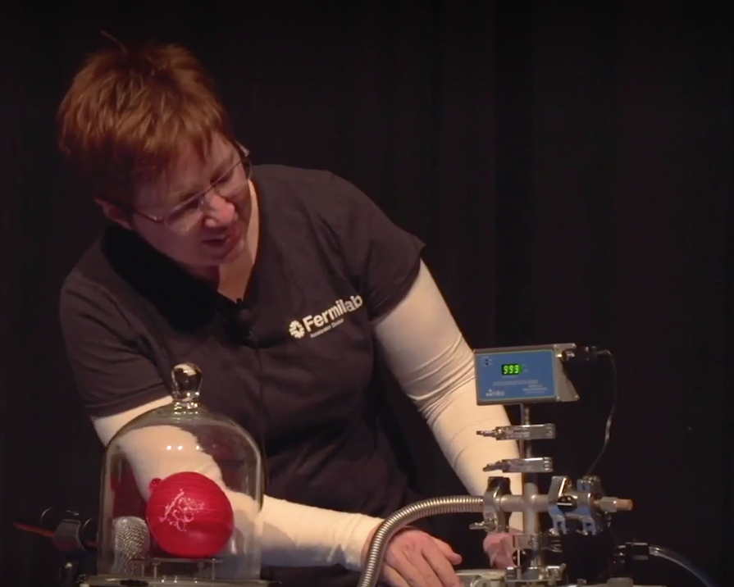
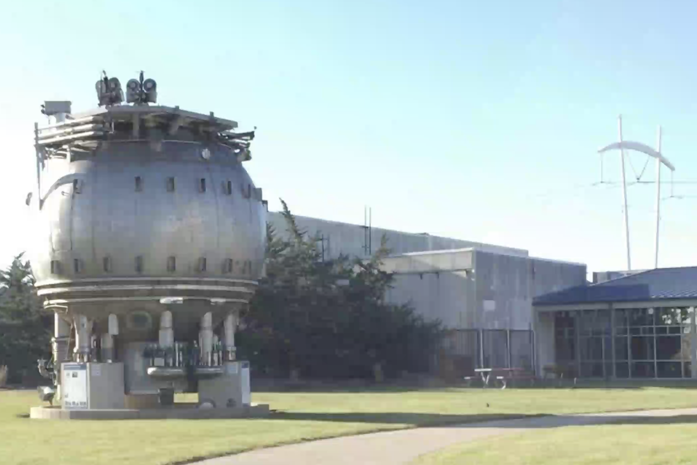
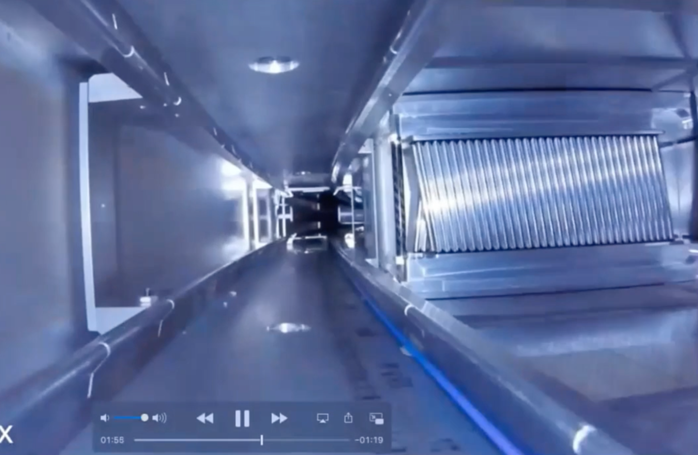
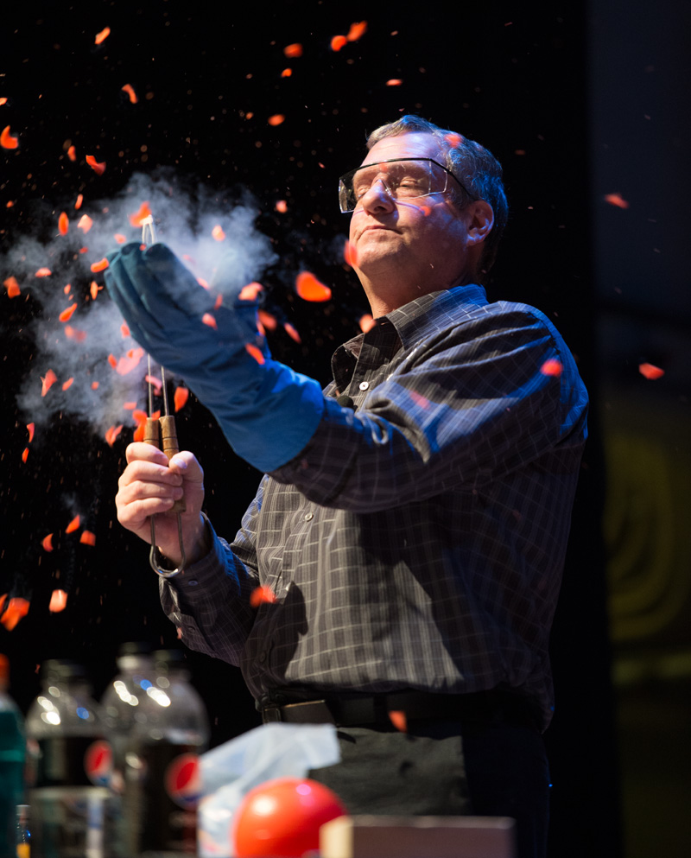
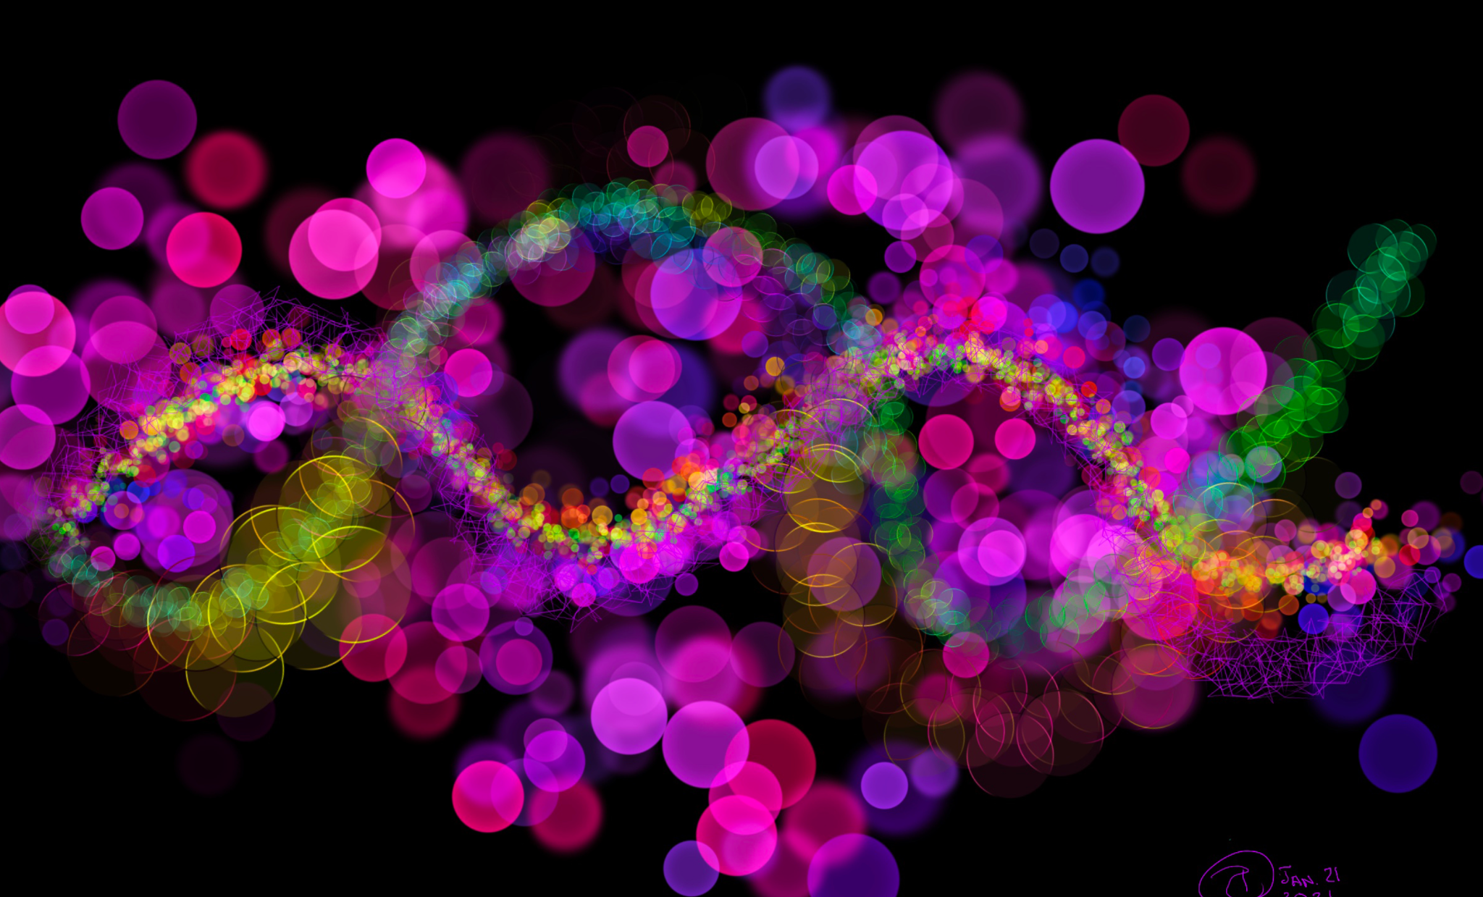
Information and Registration
https://ed.fnal.gov/events/openhouse/

